Slide 1
Current Climate Conditions
and Outlook
November 15, 2022

Slide 2
Land Acknowledgement
I respectfully acknowledge that the land I live on, and work on (with Colorado State University), are the traditional and ancestral homelands of the Arapaho, Cheyenne, and Ute nations and peoples.
https://landacknowledgment.colostate.edu

Slide 3
Download
Presentation
climate.colostate.edu/pdfs/curr_conditions_nov2022.pdf

Slide 4
Scan this code to download May workshop presentation.
Helpful links and emails included for later reference.
Download
Presentation
climate.colostate.edu/pdfs/CO_drought_resources.pdf

Slide 5
We monitor drought and climate conditions weekly!
Check out our Colorado Drought Update page for resources.
climate.colostate.edu/drought
SCAN ME

Slide 6
Overview
Current Conditions
Precipitation
Snowpack
Temperature
Streamflow
Soils and vegetation
Evaporative demand
Outlook
Next week
8-14 day
Monthly and seasonal

Slide 7
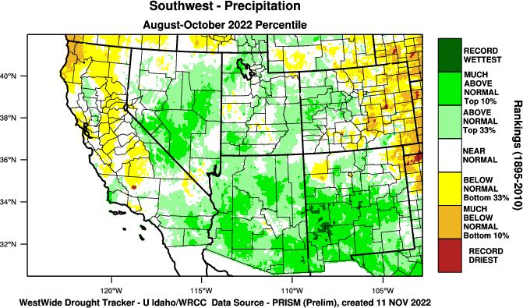
https://wrcc.dri.edu/wwdt/index.php?region=sw

Slide 8
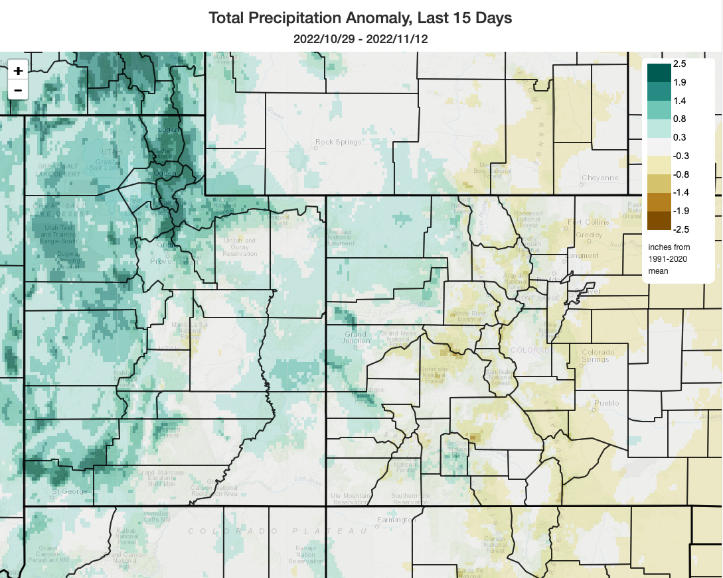
https://climatetoolbox.org/tool/climate-mapper

Slide 9
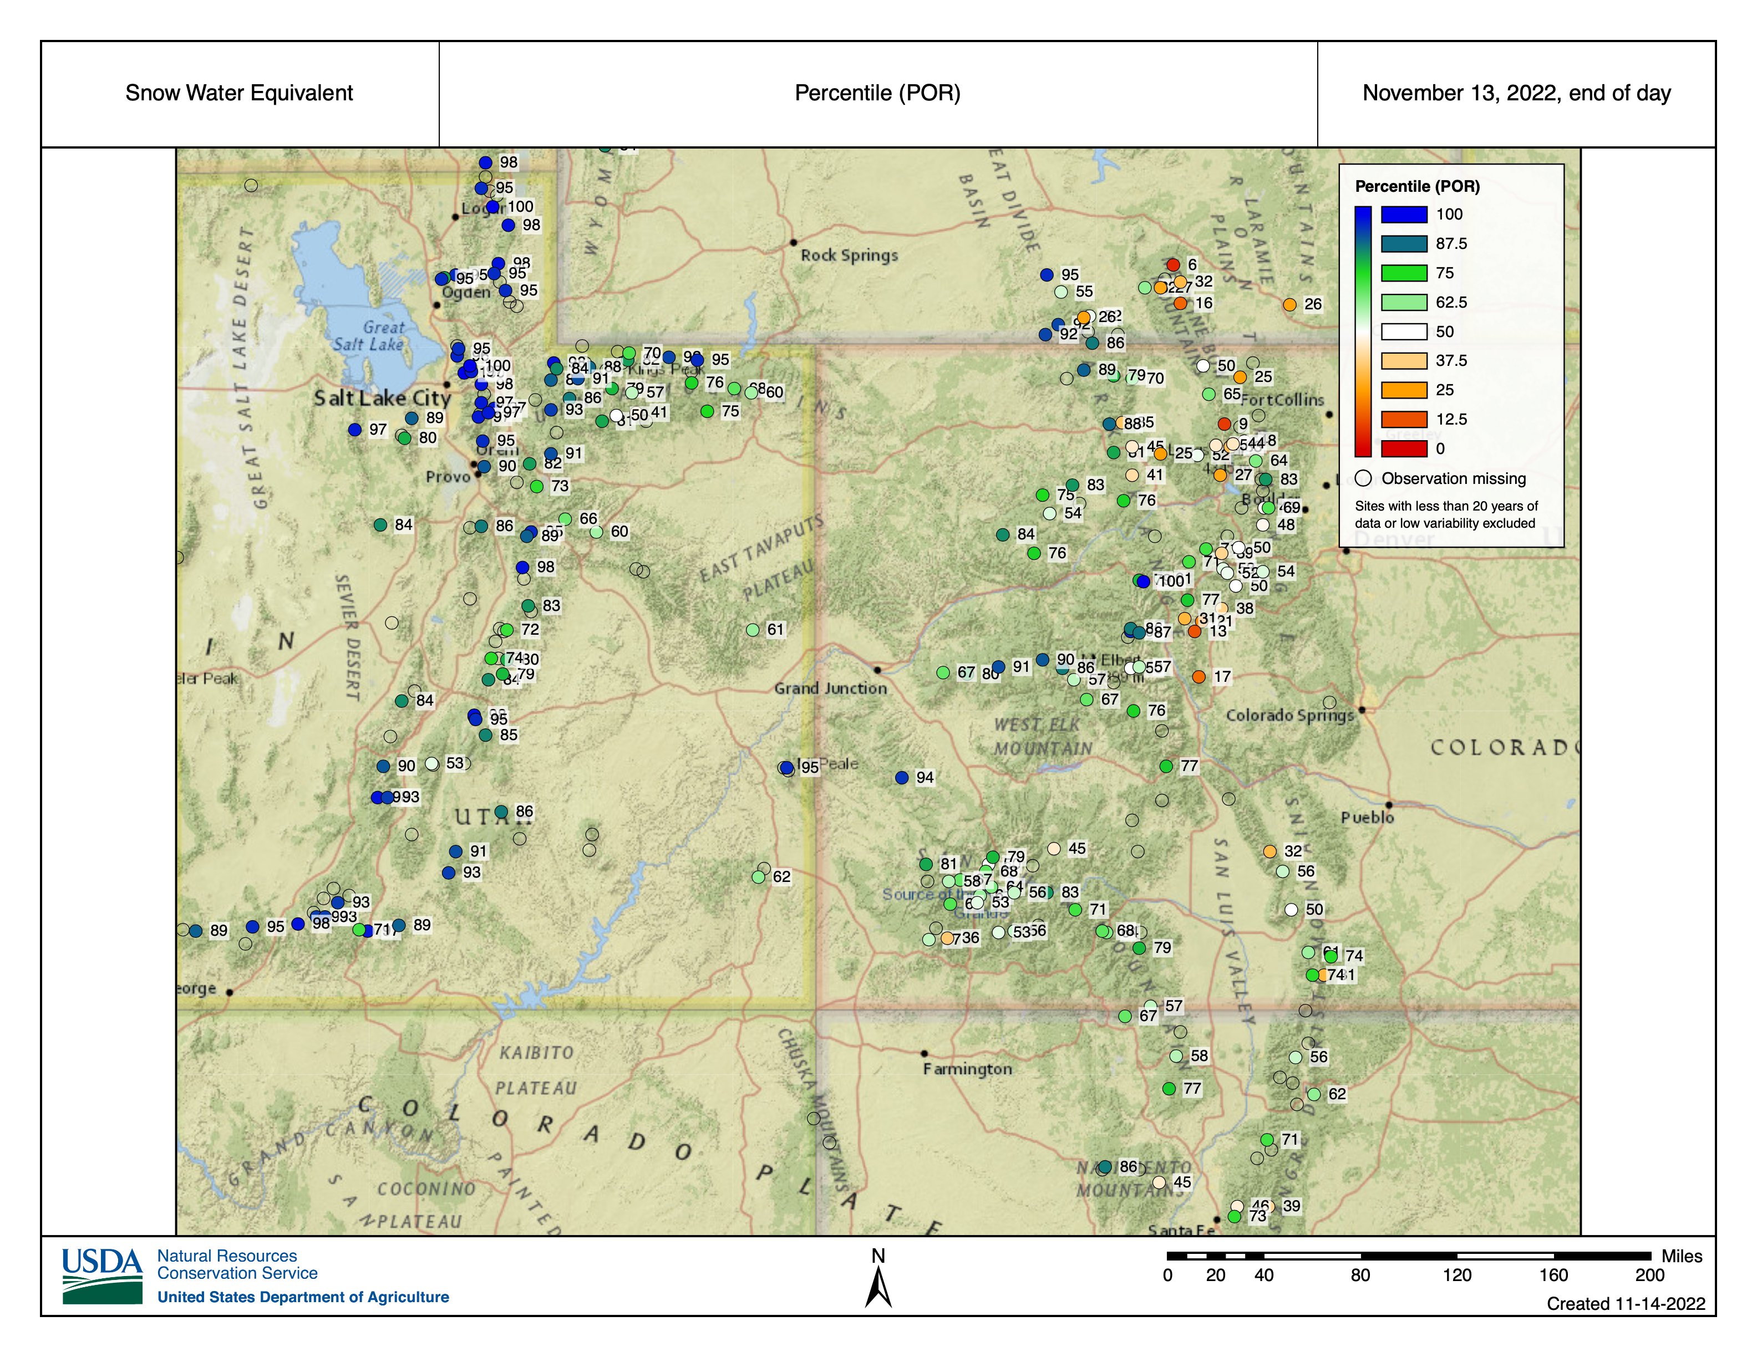
https://www.nrcs.usda.gov/wps/portal/wcc/home/quicklinks/imap

Slide 10
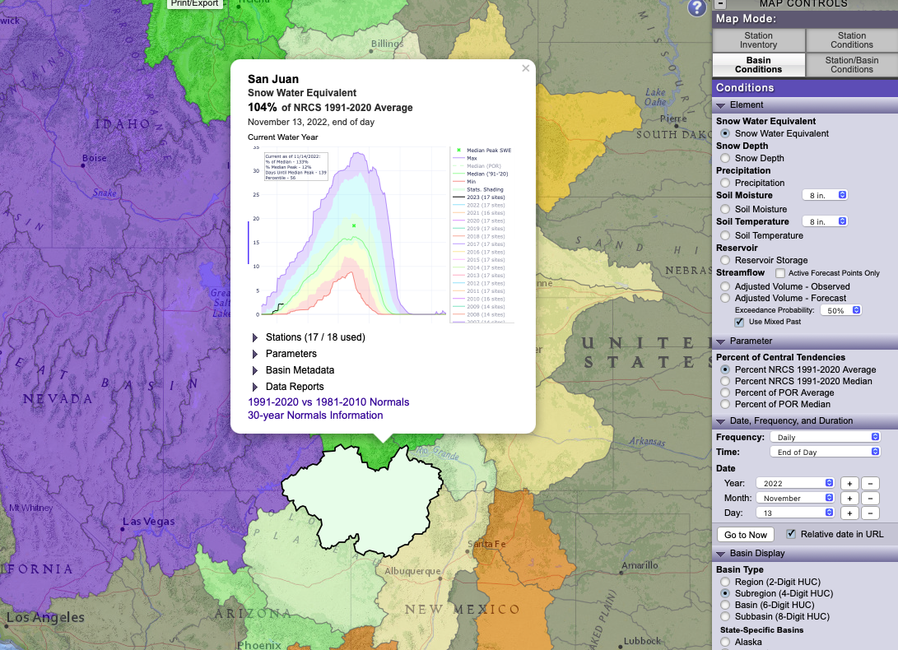
Click on a station or basin in the interactive map to see the time series graphic!

Slide 11
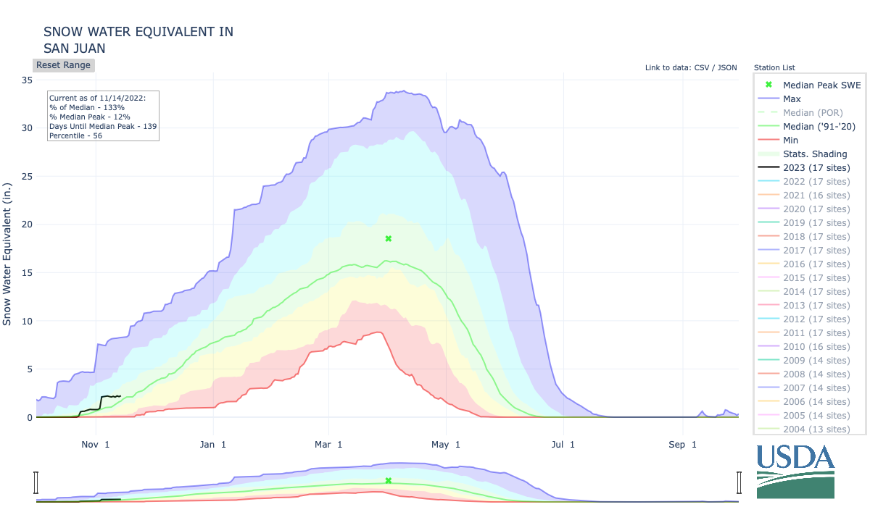

Slide 12
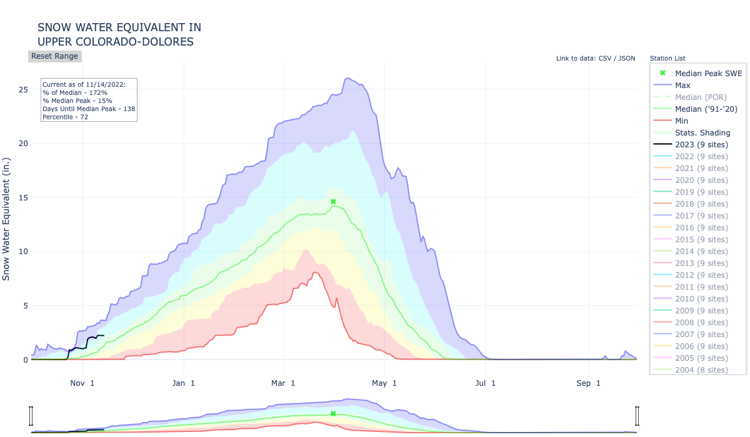

Slide 13
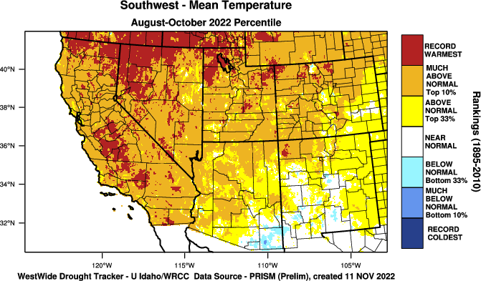
https://wrcc.dri.edu/wwdt/index.php?region=sw

Slide 14
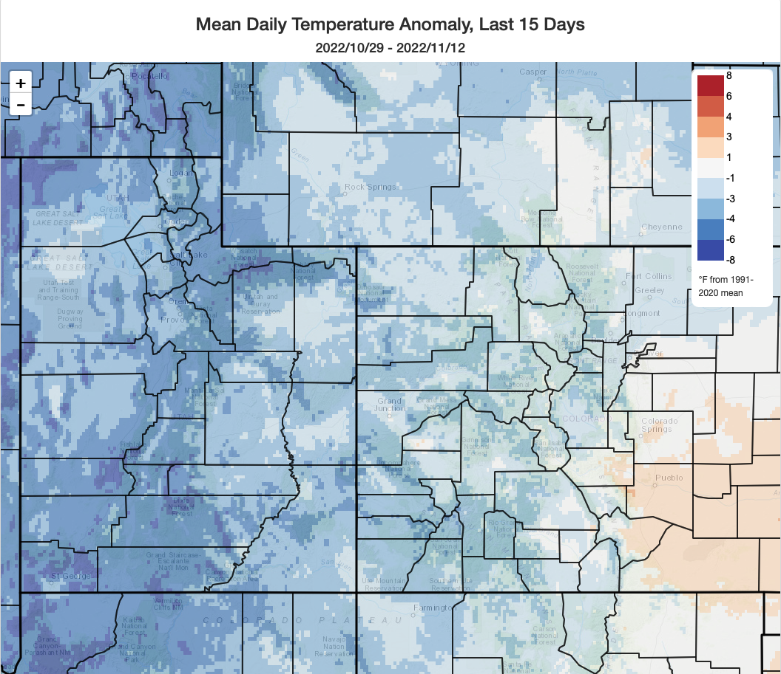
https://climatetoolbox.org/tool/climate-mapper

Slide 15
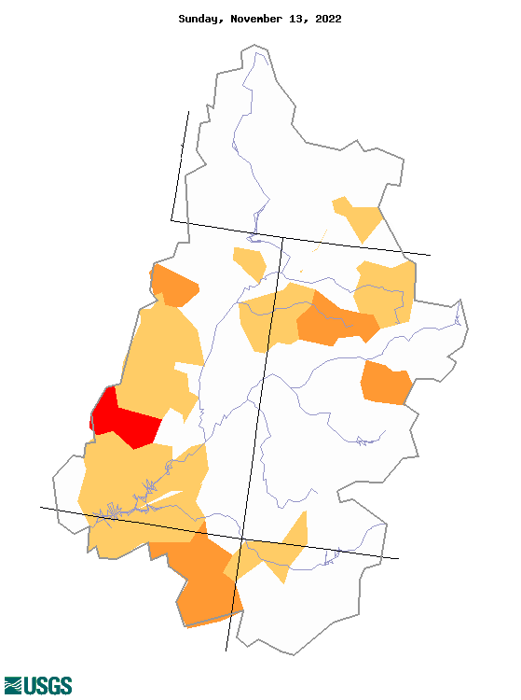
28-day averaged low streamflows
https://waterwatch.usgs.gov/

Slide 16
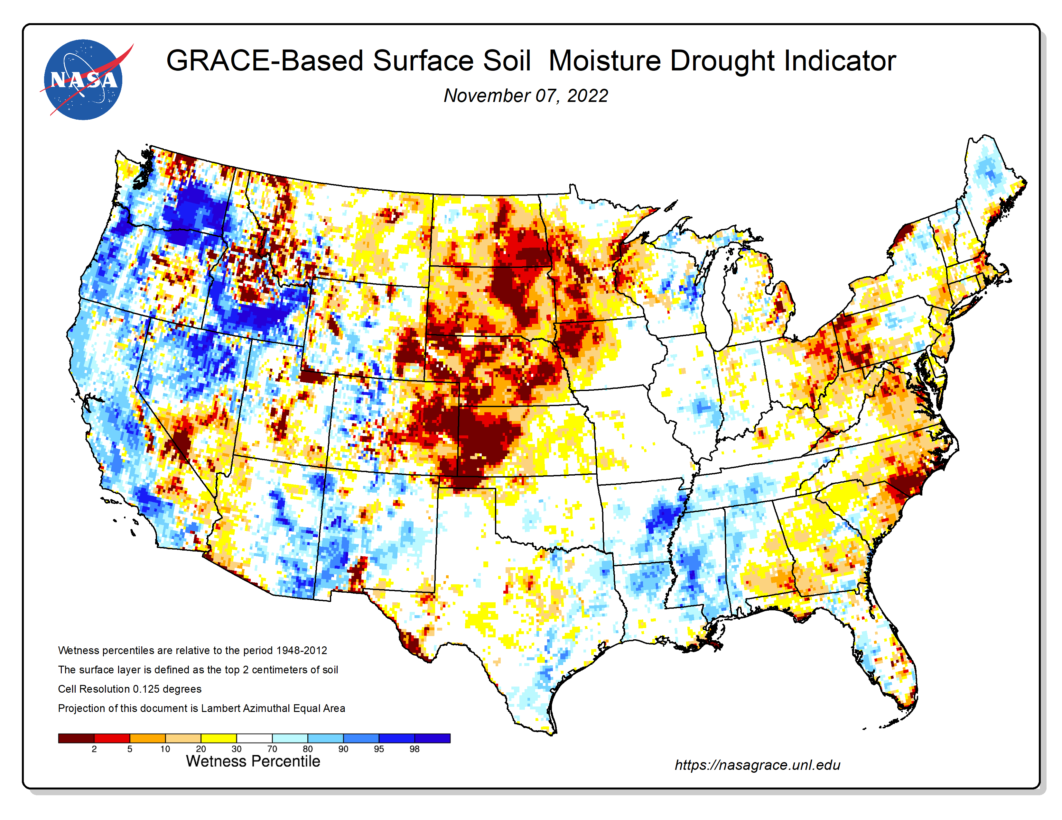
NASA’s GRACE has soil moisture and groundwater estimates

Slide 17
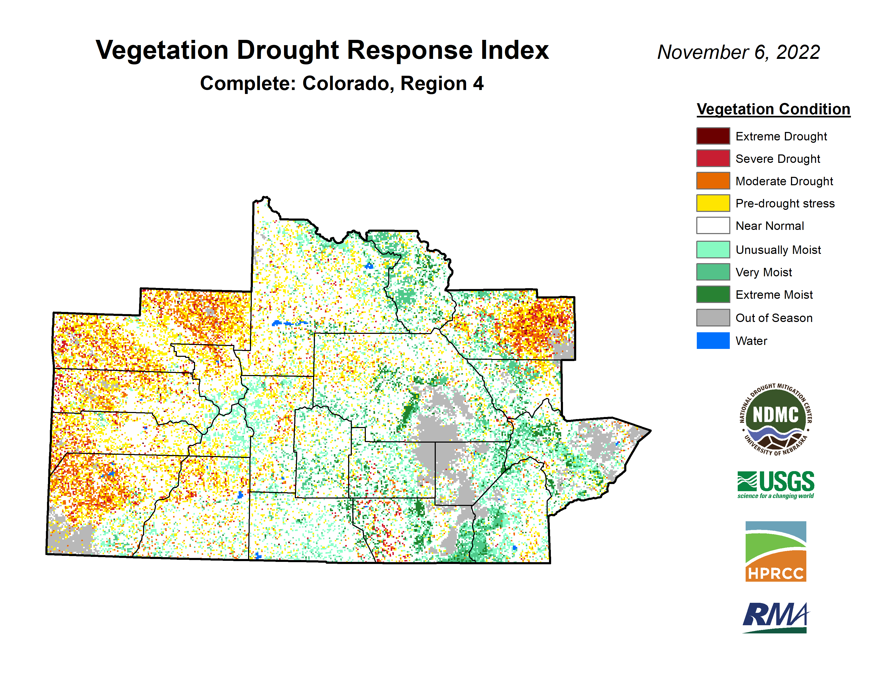
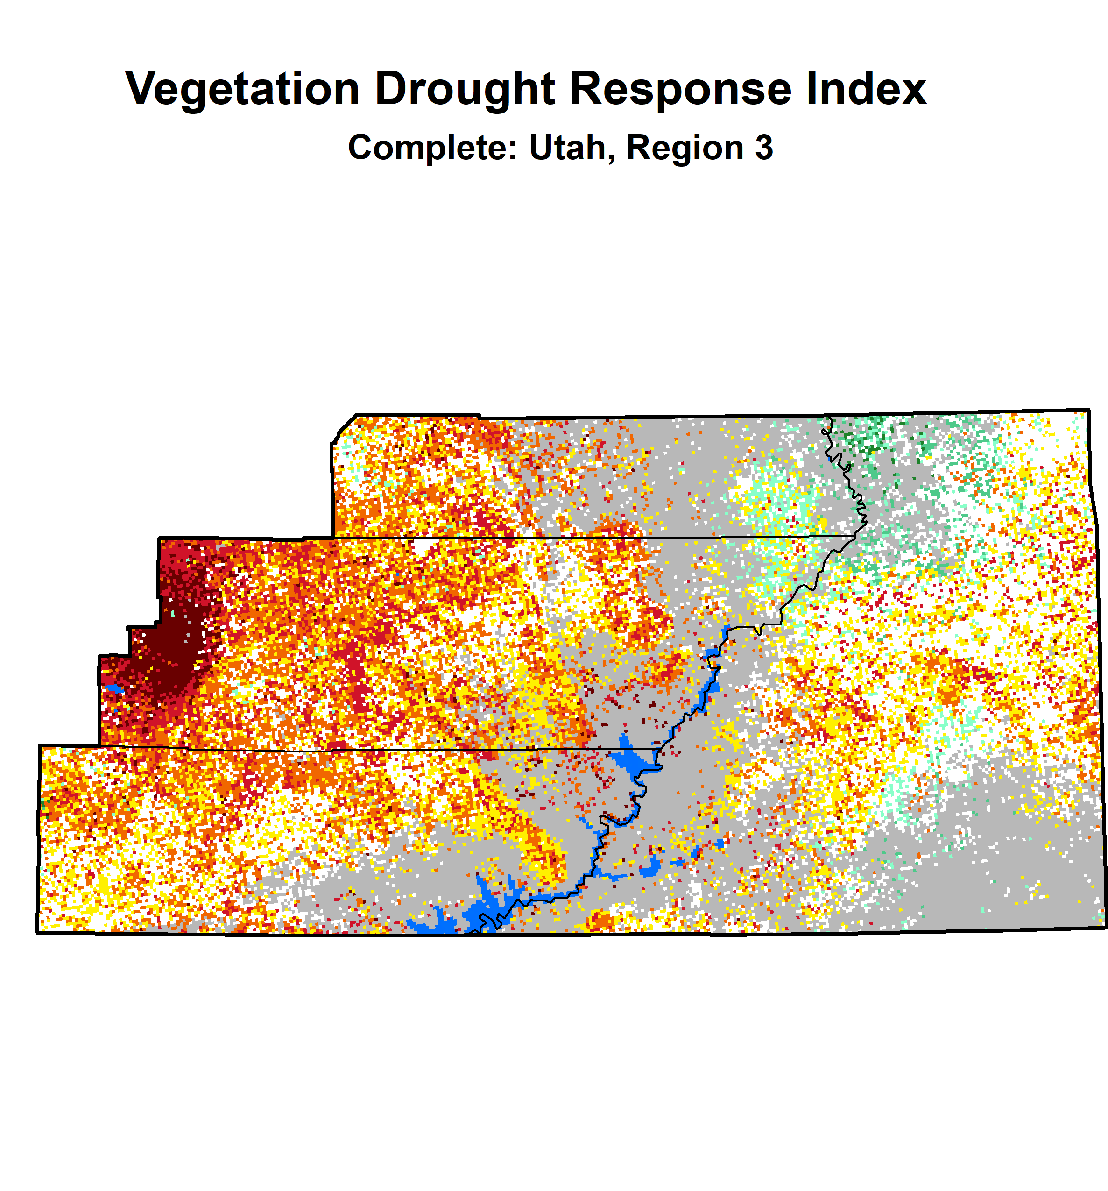
https://vegdri.unl.edu

Slide 18
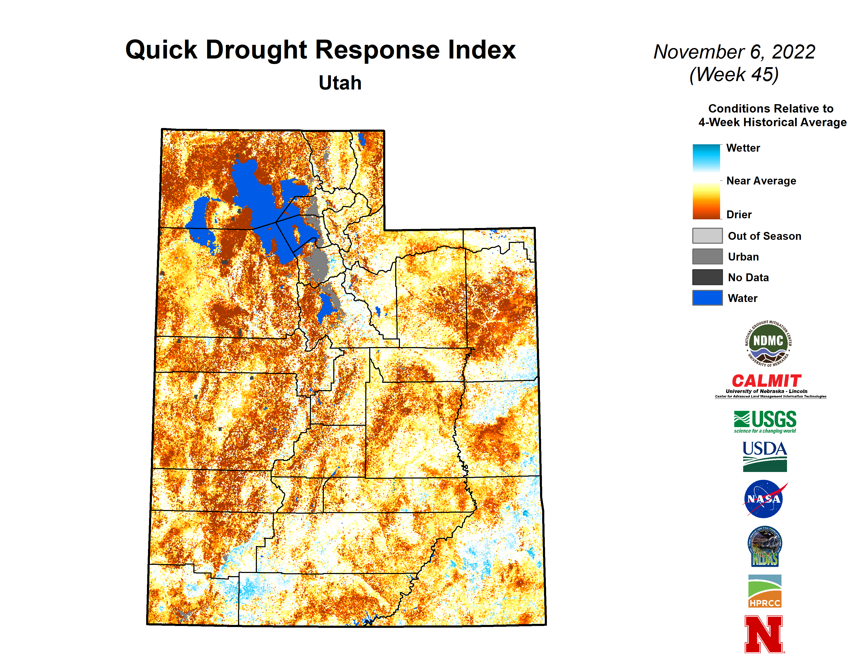
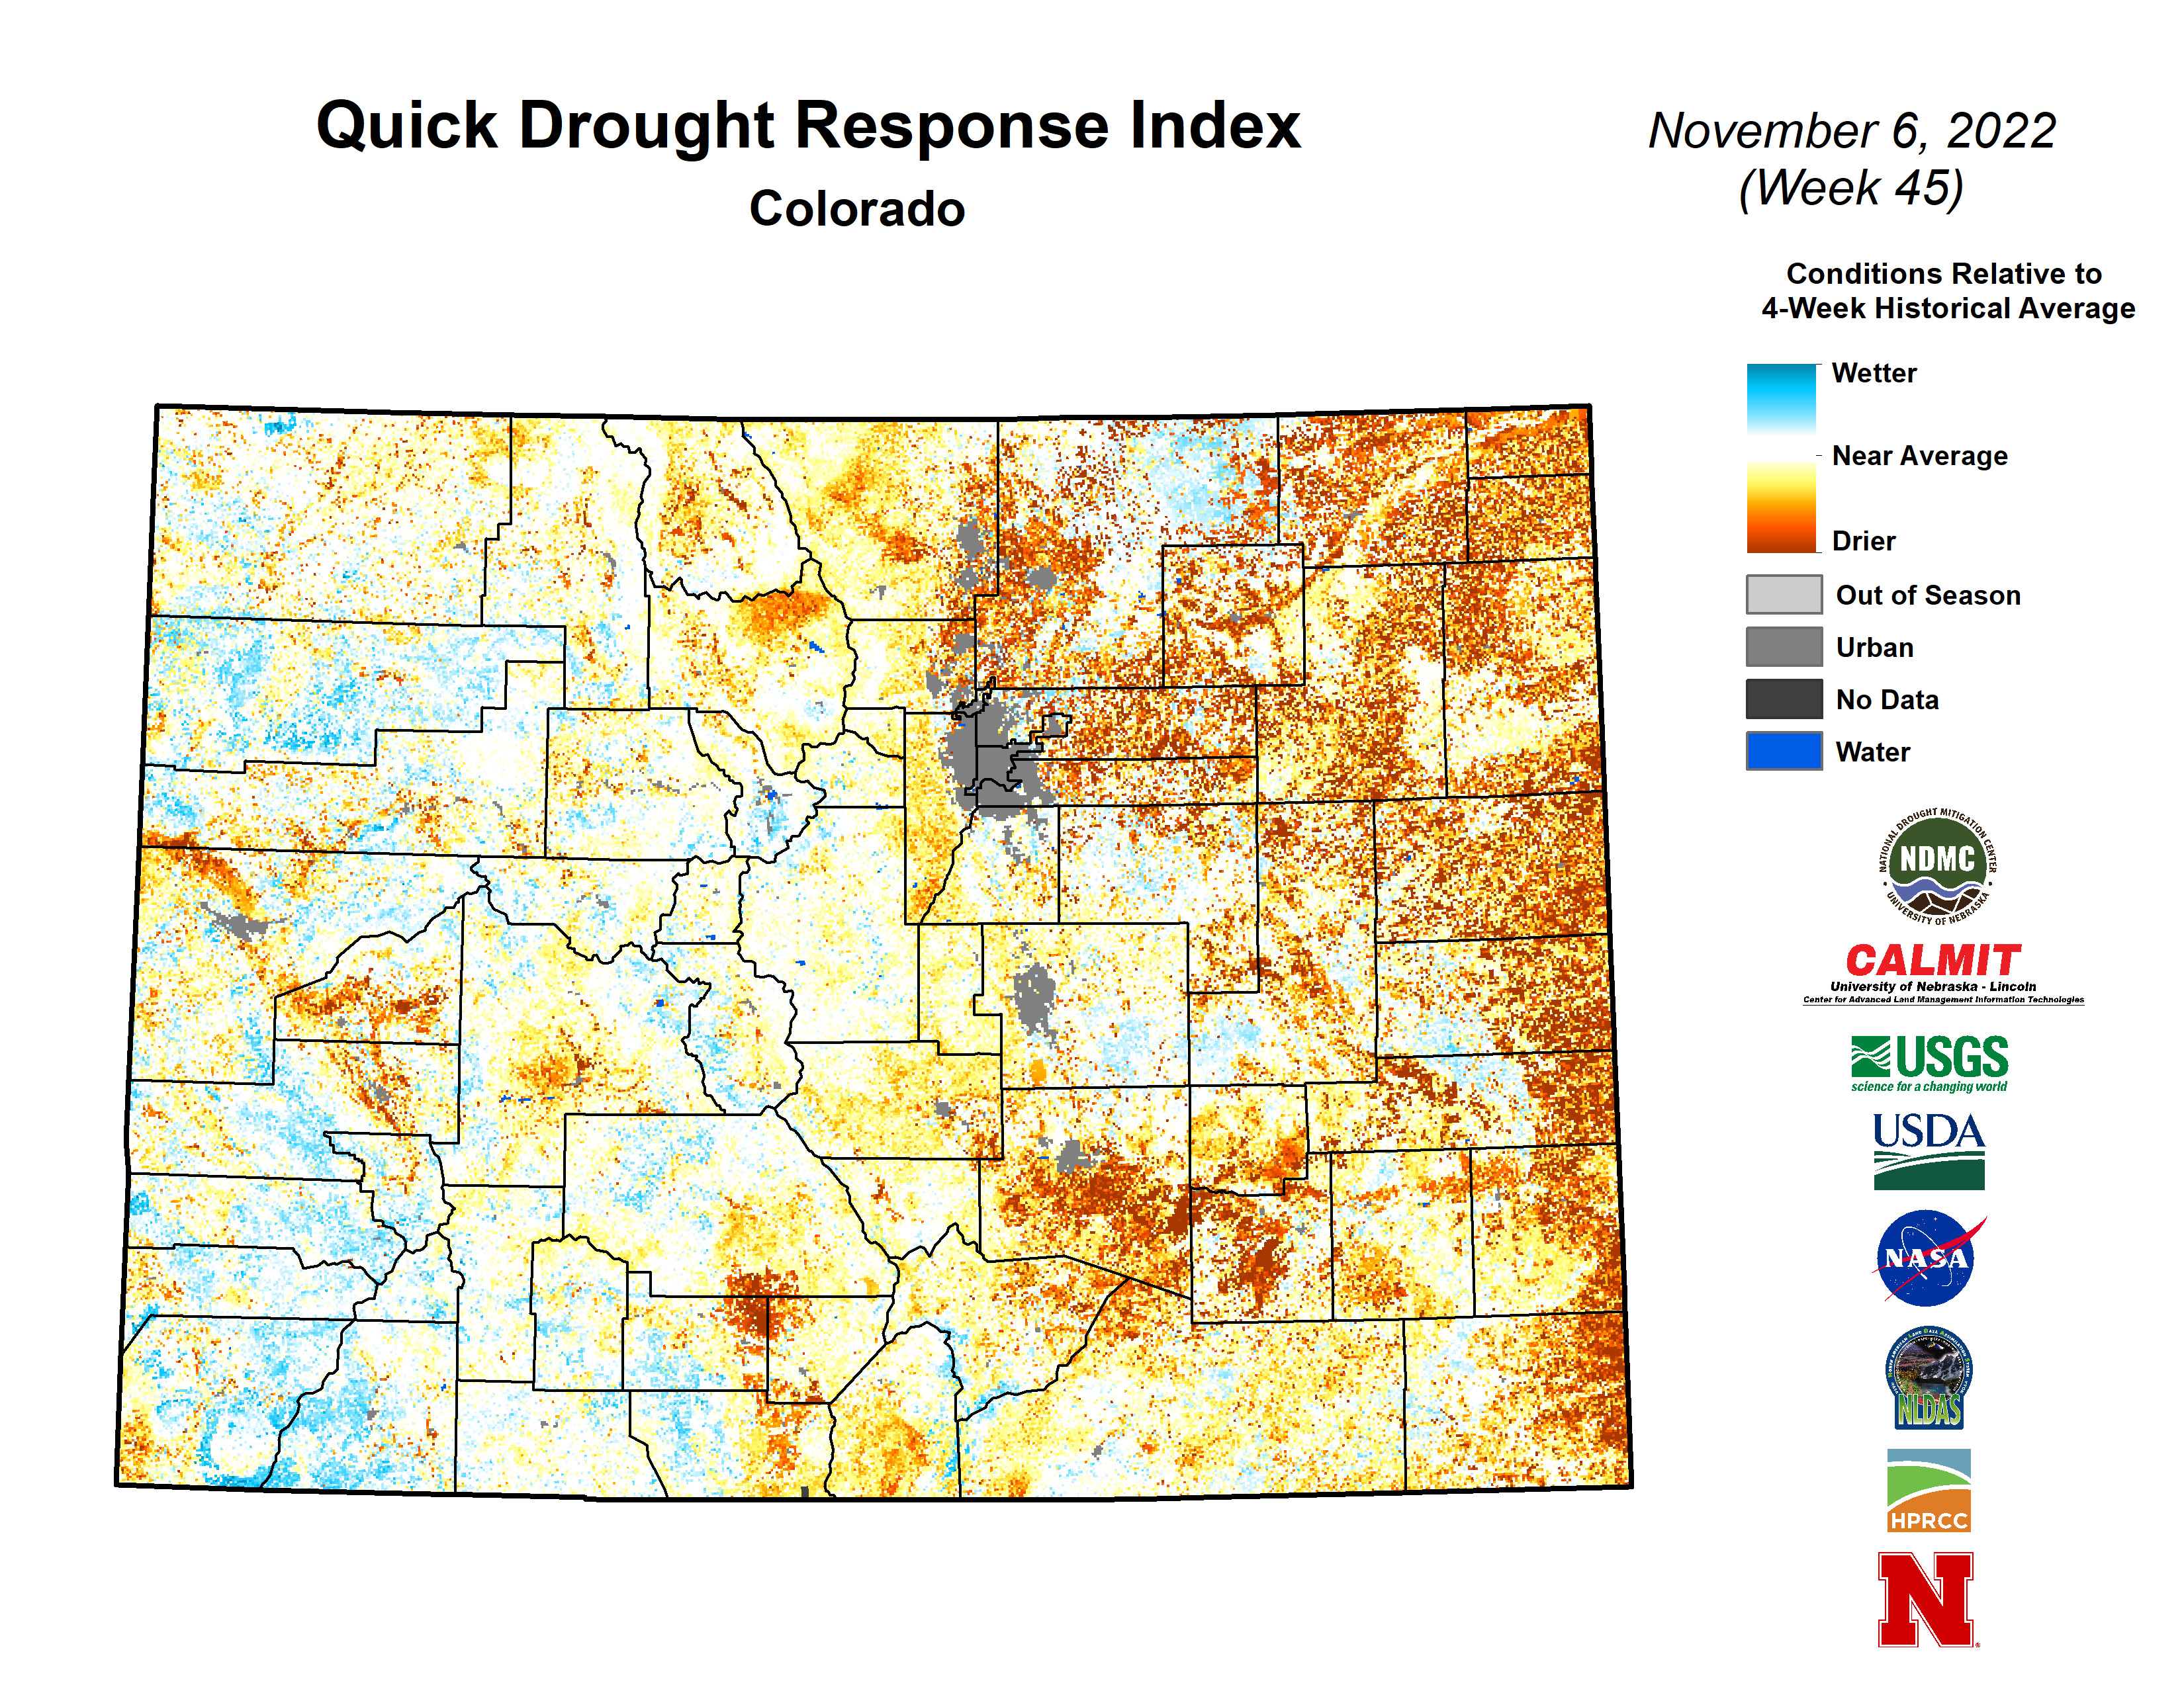
https://quickdri.unl.edu

Slide 19
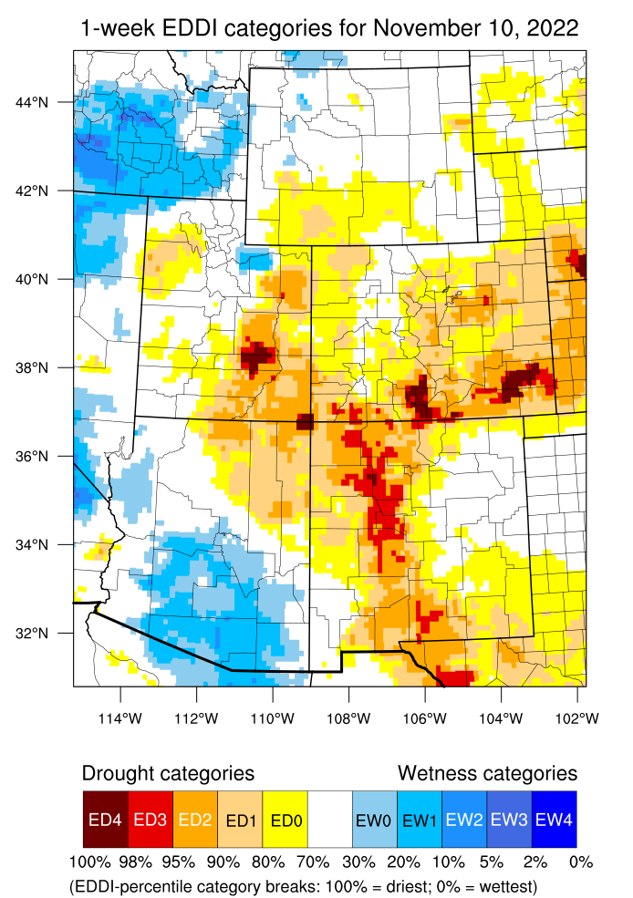
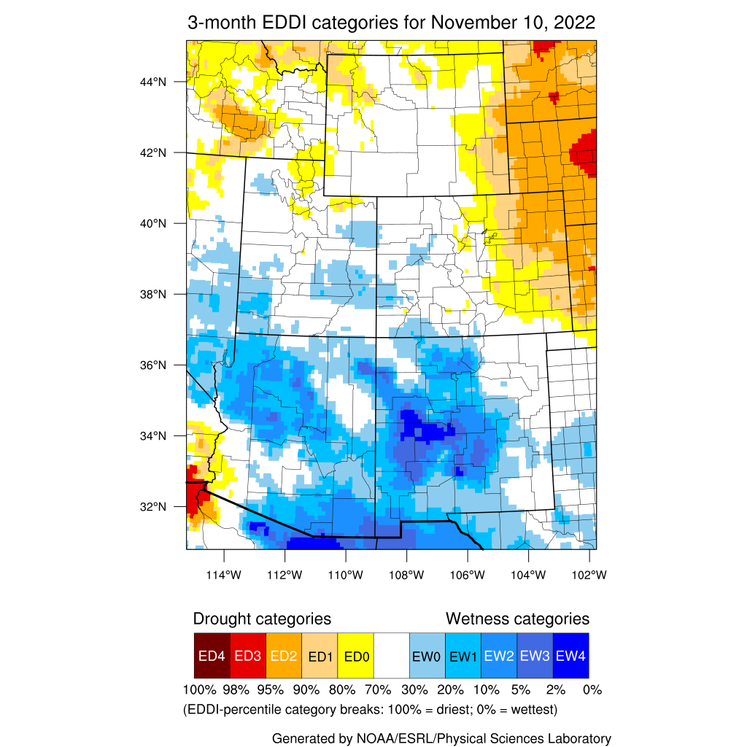
https://psl.noaa.gov/eddi/
What happens in the atmosphere is as important as what’s happening on the ground!
EDDI looks at temperature, humidity, solar radiation, and wind, and compares current conditions to that same time period in history.
When the atmosphere is more “thirsty” it tries to take more water from the ground.

Slide 20
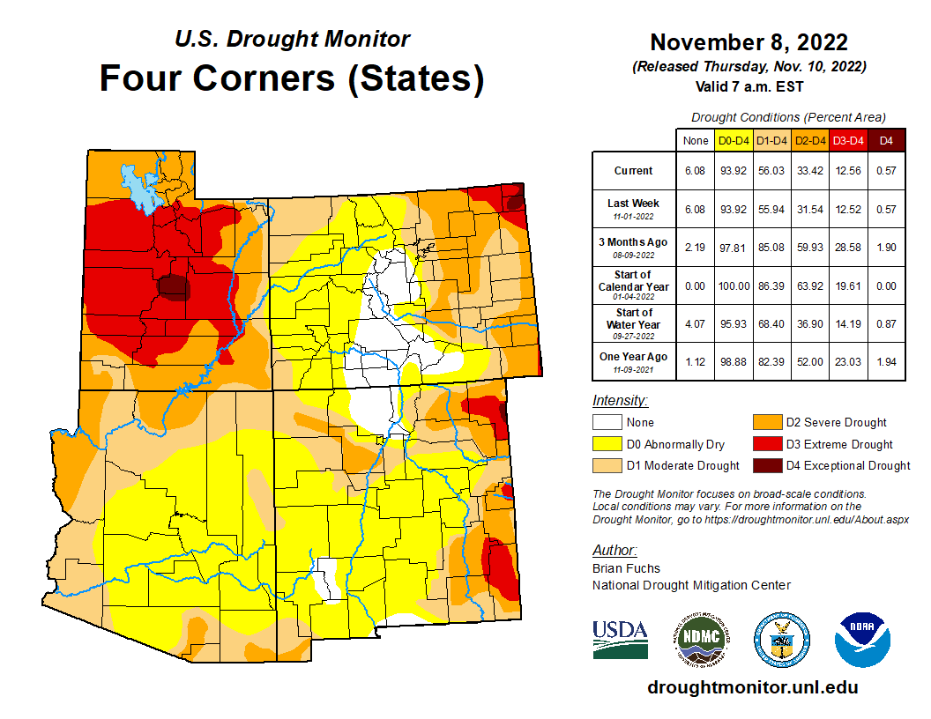

Slide 21
Key Takeaways
Good monsoon moisture and a decent start to the snowpack season has helped improve soil moisture conditions
Temperatures have been warm, but overall, evaporative demand has been lower than average
Vegetation, soils are okay. Could be better, but is better than it’s been in recent years
Long-term hydrologic drought is still evident in streamflows
Overall drought improvement has occurred throughout the summer and fall

Slide 22
Outlook

Slide 23
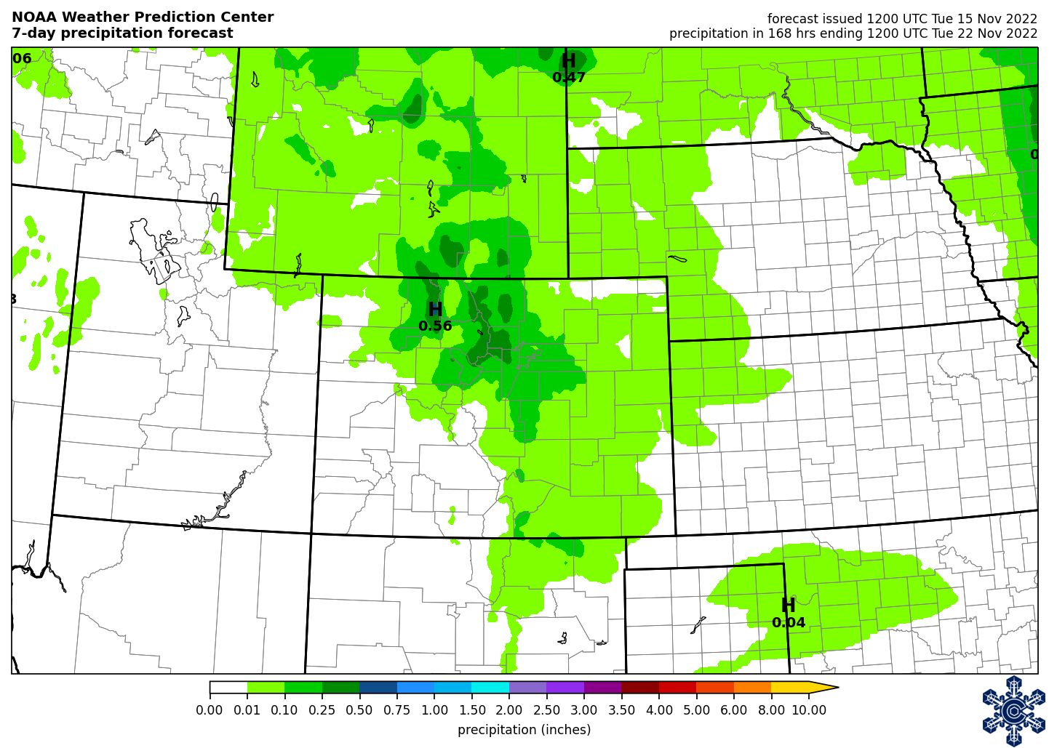
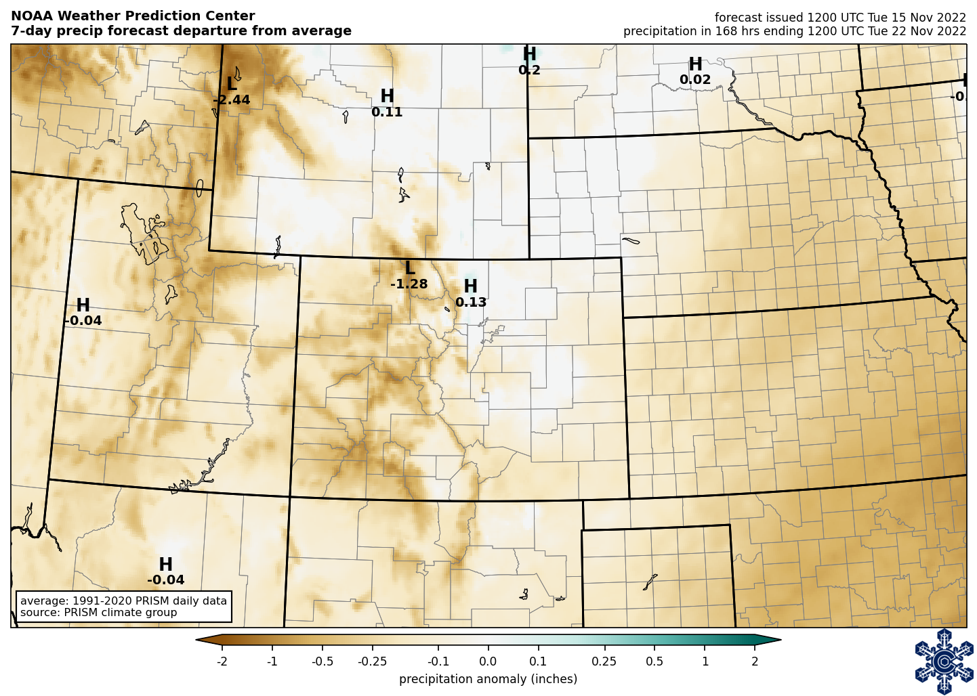
https://climate.colostate.edu/drought/

Slide 24
https://climate.colostate.edu/ski-dashboard/

Slide 25
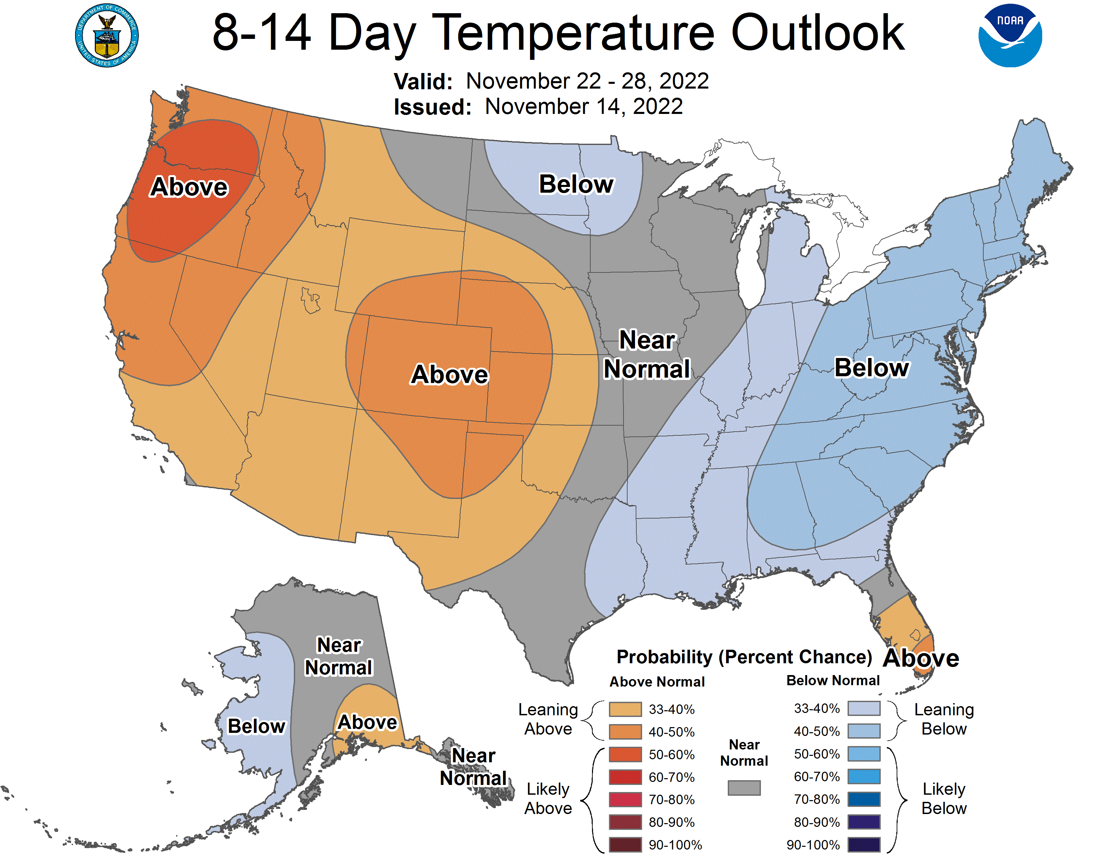
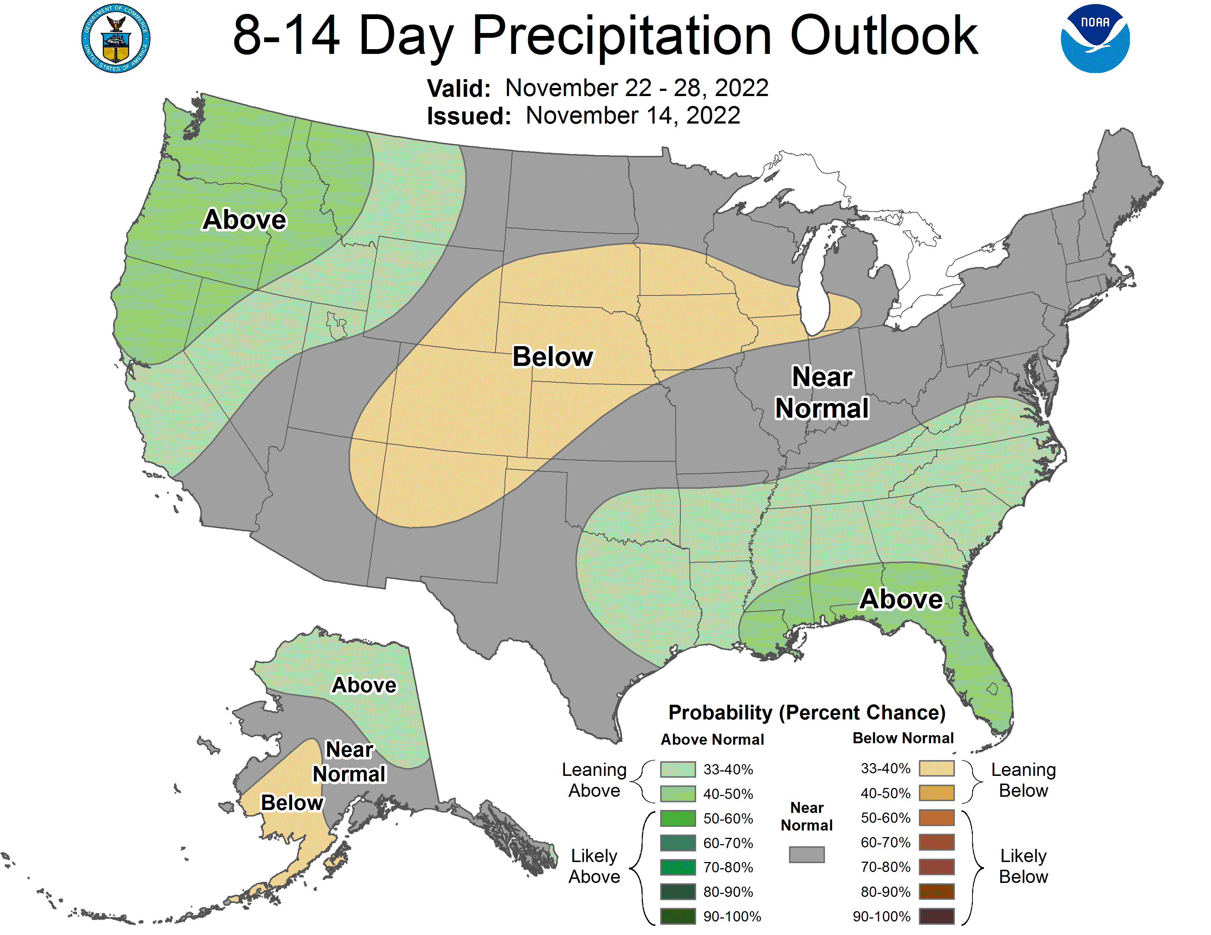
https://www.cpc.ncep.noaa.gov

Slide 26
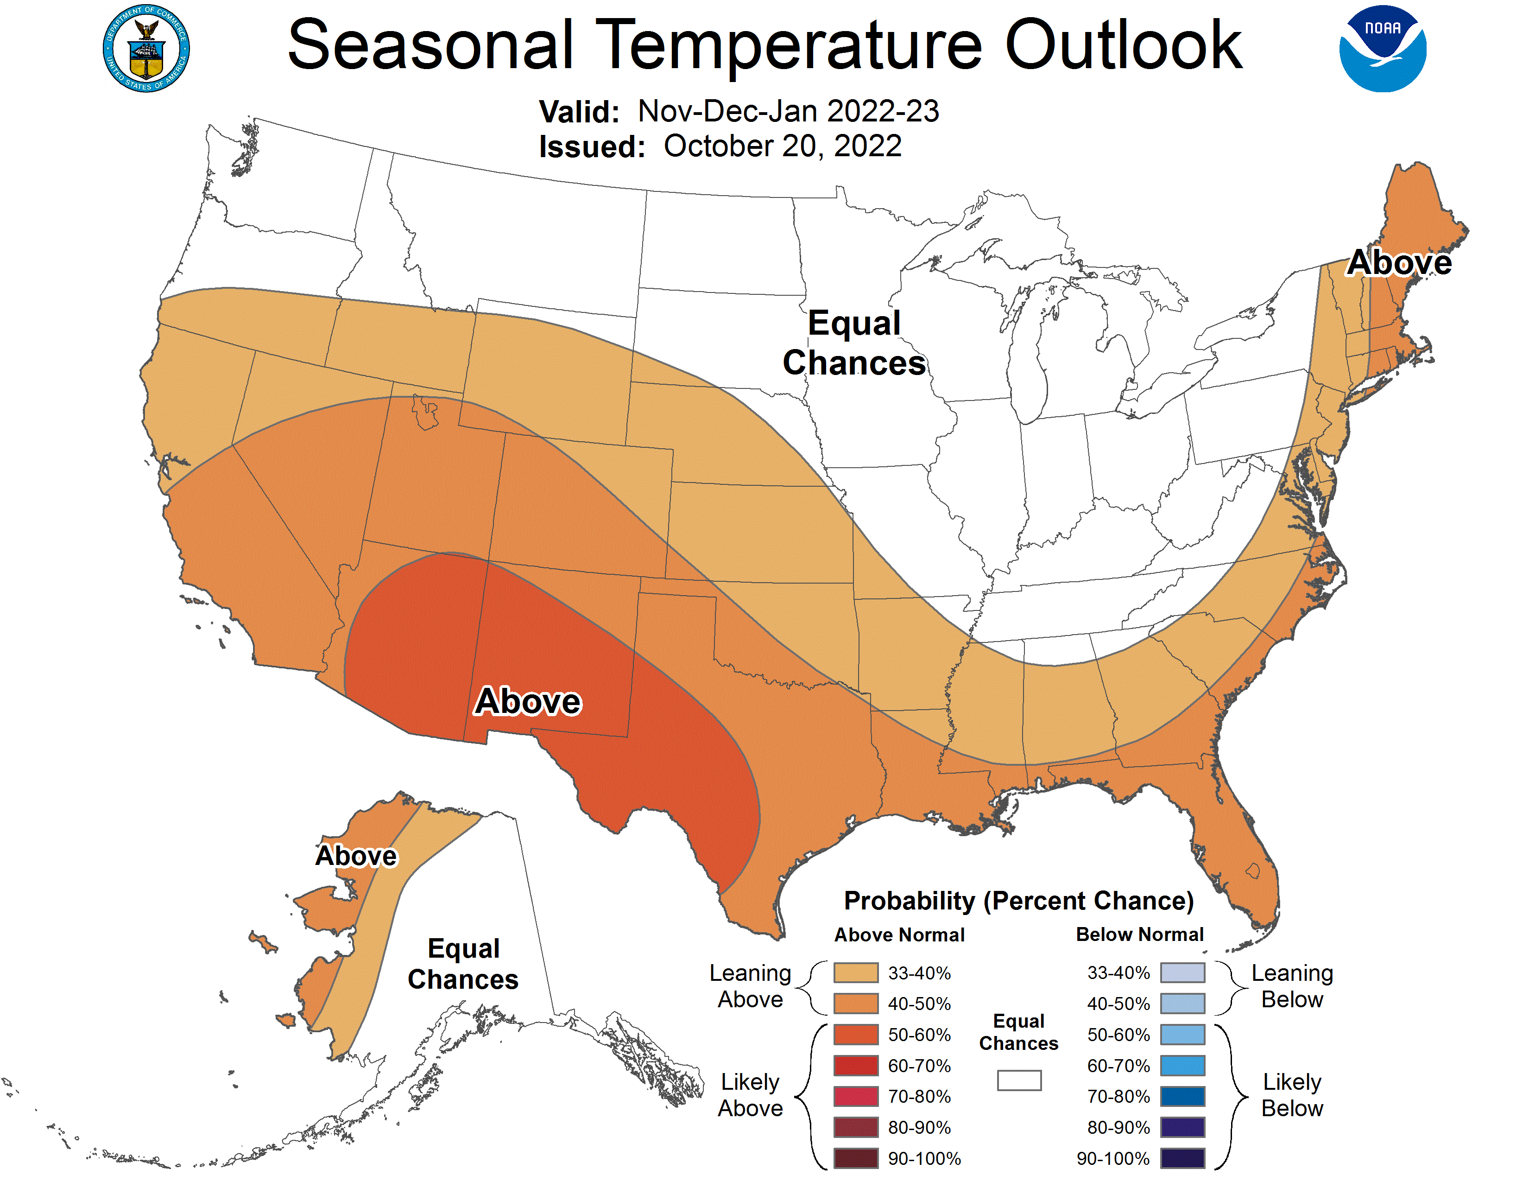
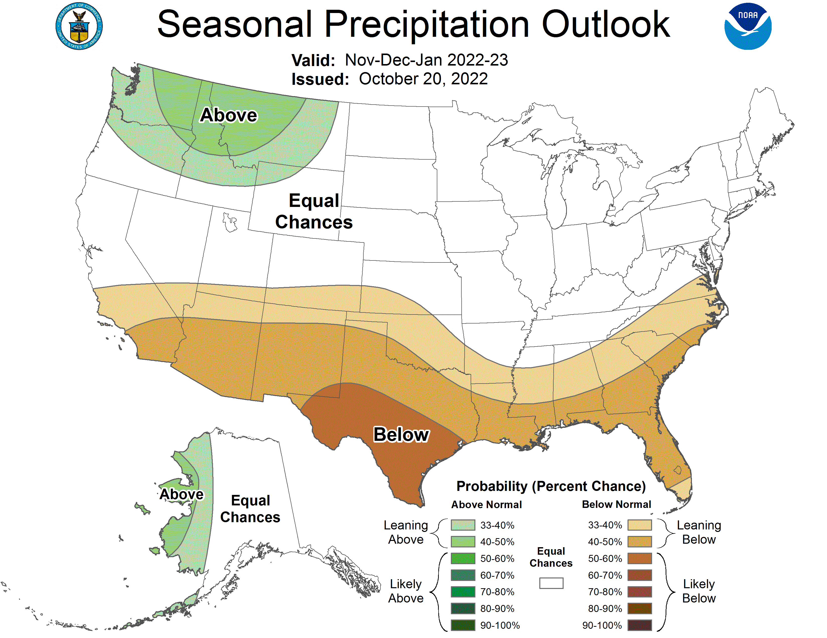
https://www.cpc.ncep.noaa.gov

Slide 27
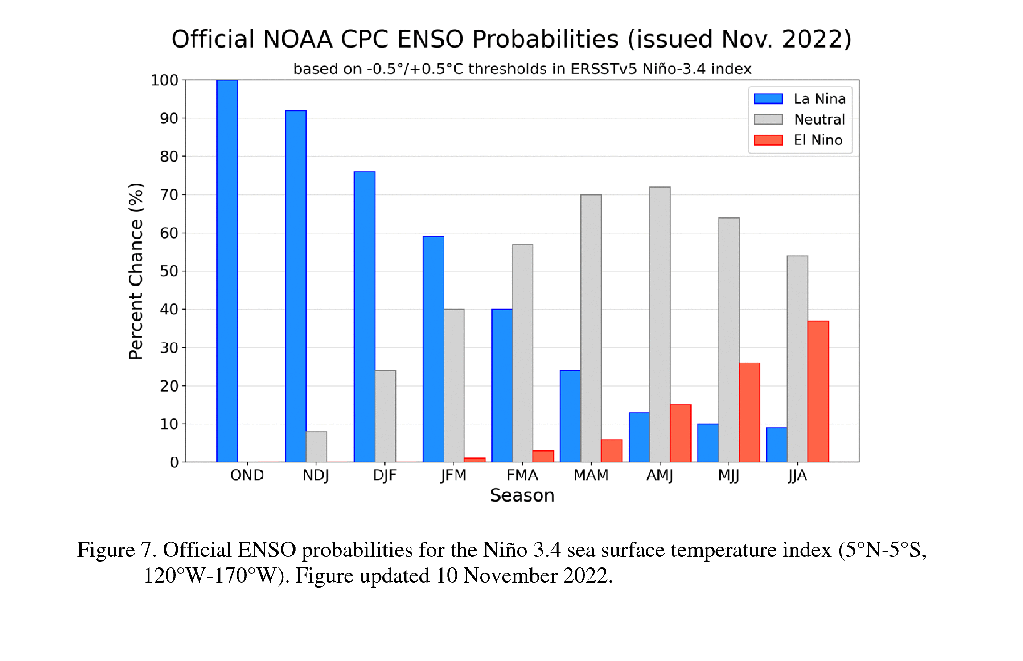
https://iri.columbia.edu/our-expertise/climate/forecasts/enso/current/

Slide 28
Key Takeaways
Drier conditions look to dominate over the next couple of weeks.
La Niña conditions will continue through the winter and into spring
La Niña favors the northern mountains for winter snow, with less than average more likely over southern mountains (including San Juans)
Warmer than average conditions are more likely as we head into winter
What to watch for
Better soil conditions now should help during melting season
It’s still early, how will the season progress over the next 4 months?
Near normal snowpack is good, but melting needs to be consistent and slow
Early peak and early melt (like last year) will be rough on water supplies
We need an above average peak snowpack to recover from long-term hydrologic drought conditions

