Slide 1

WERA 102
Colorado State Report for 2014
Nolan Doesken
Colorado Climate Center
Colorado State University

Slide 2
Highlights:
Remarkable year – near average in many respects
This was greatly appreciated after Sept 2013 flood
-- 2014 Growing season relatively short
-- No extreme heat
-- Below average potential ET
-- wildfires few and not furious
-- Surface water supplies good, crops good (and that’s good!)
--Steady drought recovery over southern portions of the state – but some long-term impacts remain.

Slide 3
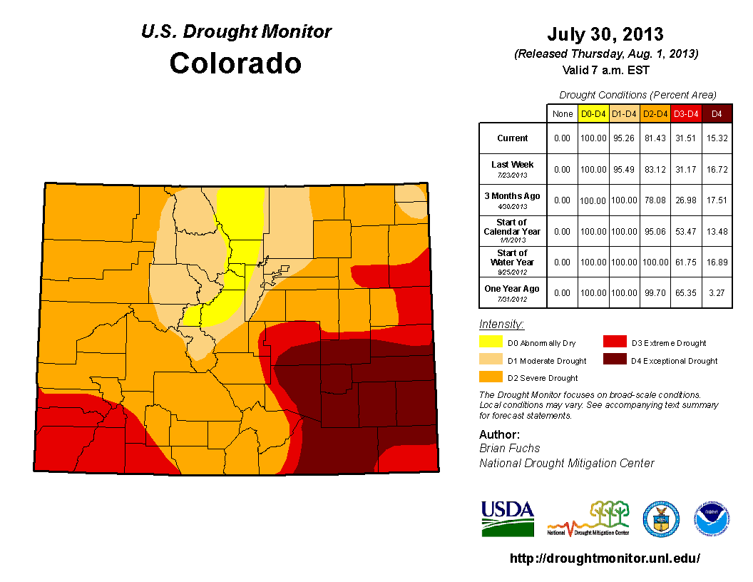

Slide 4
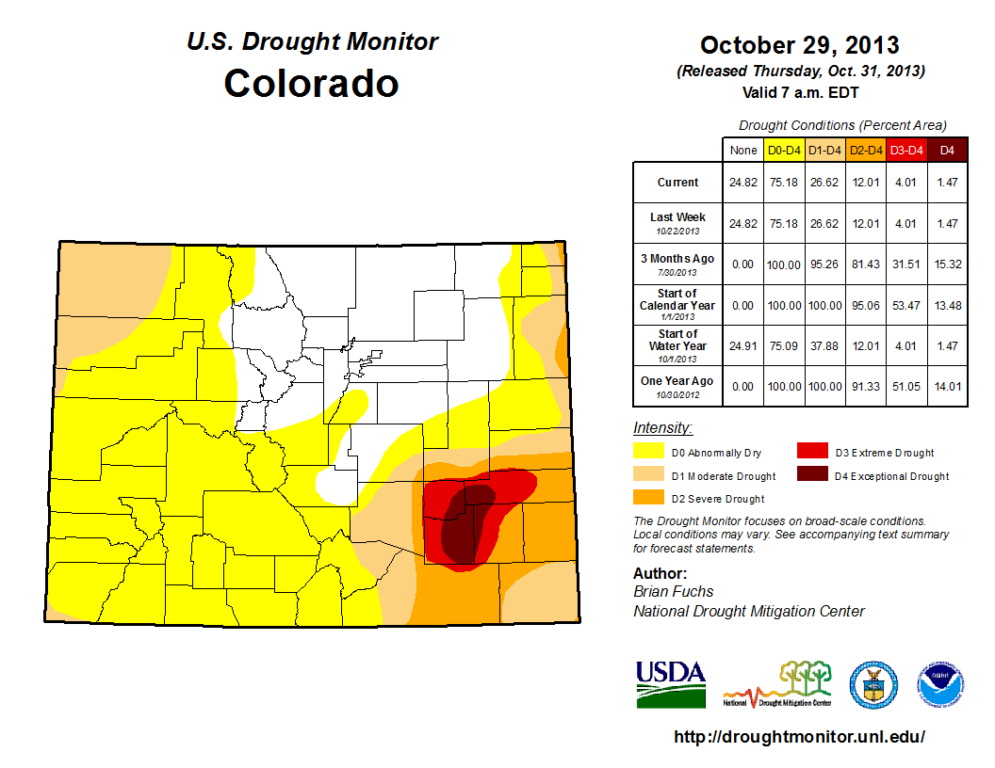

Slide 5
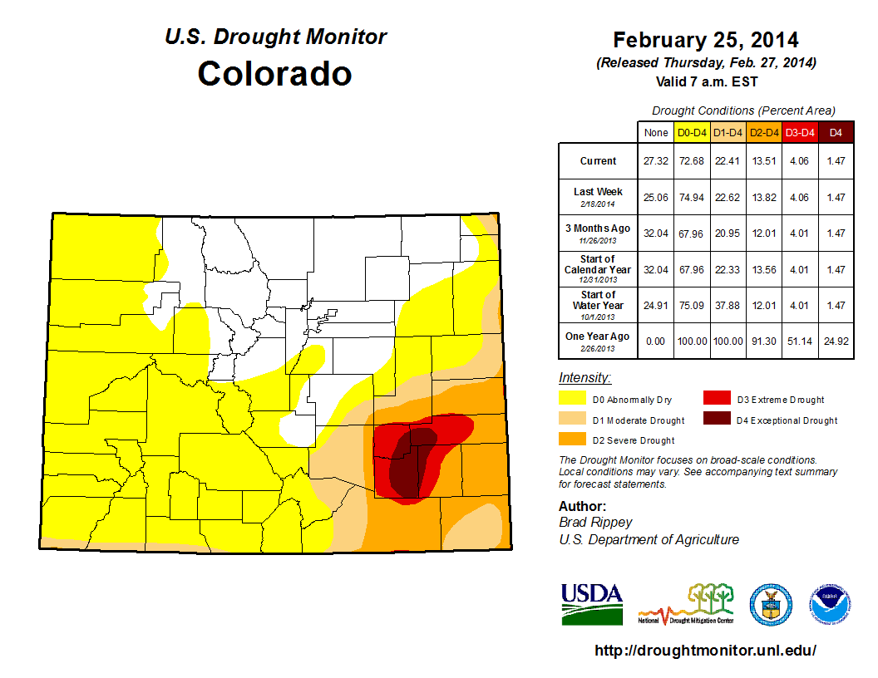

Slide 6
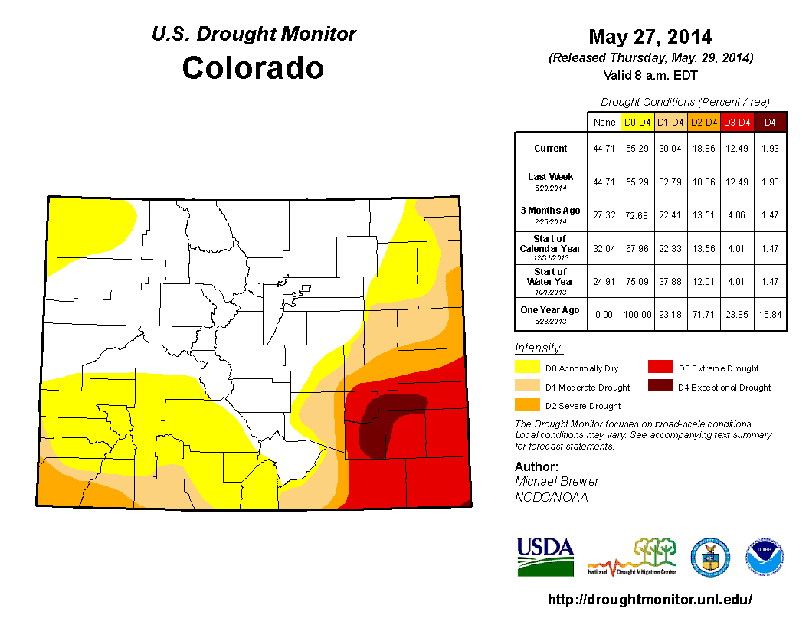

Slide 7
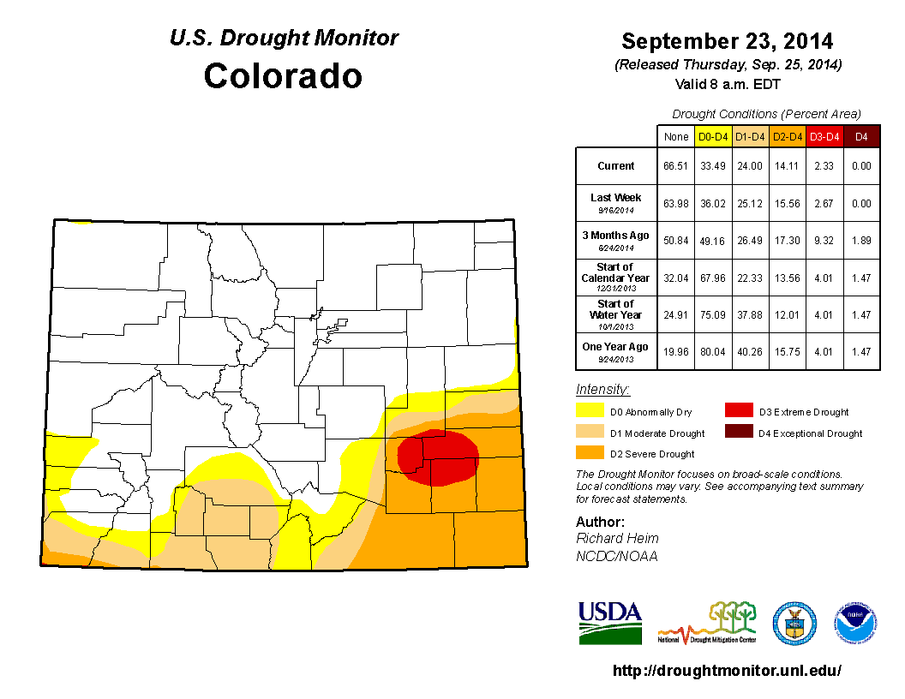

Slide 8
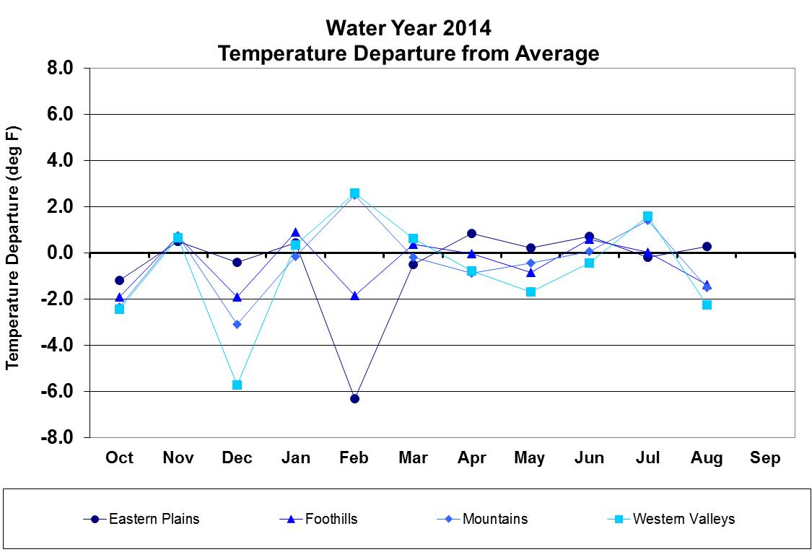
Water Year 2014 Temperature Departures

Slide 9
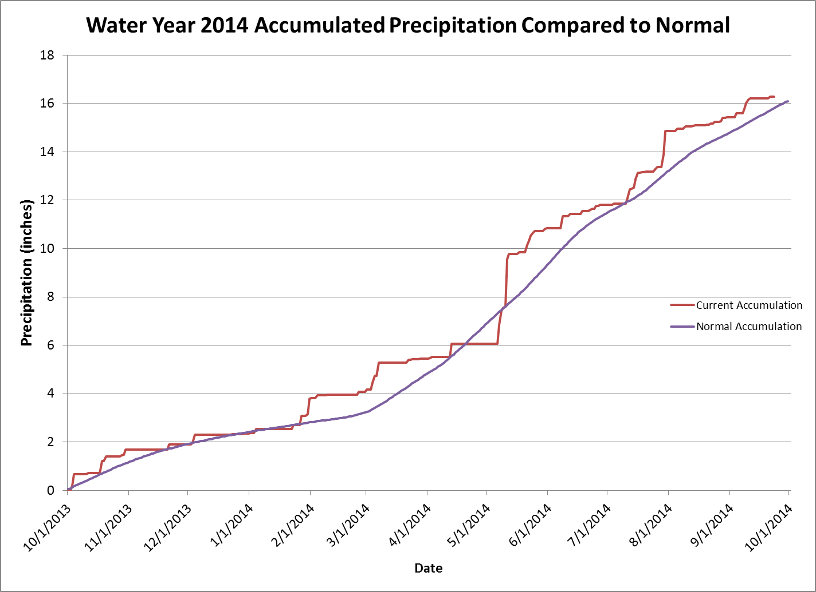
The wetter side of average

Slide 10
Accomplishments with respect to WERA 102 goals
Data collection and climate monitoring
-- Campus Weather Station
-- CoAgMet
-- CoCoRaHS
-- instrument comparisons
-- NIDIS Drought monitoring
-- Post-flood assessment

Slide 12
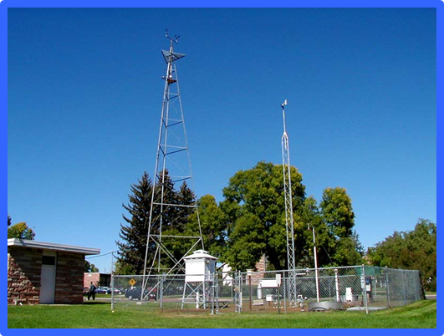
Photo by Grant Goodge – Cloudless summer day in 1988

Slide 13
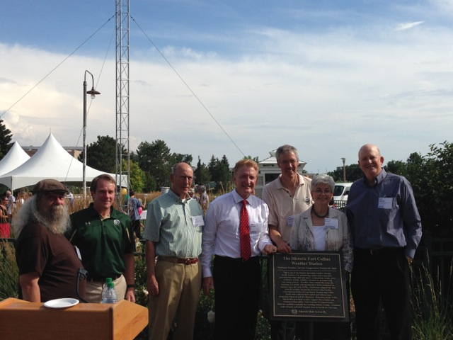
The 28 July 2014 Weather Station Celebration

Slide 14
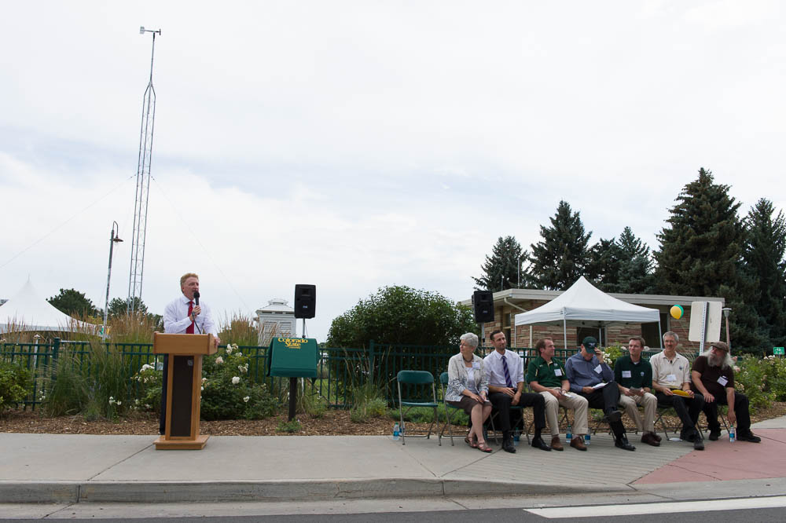

Slide 15
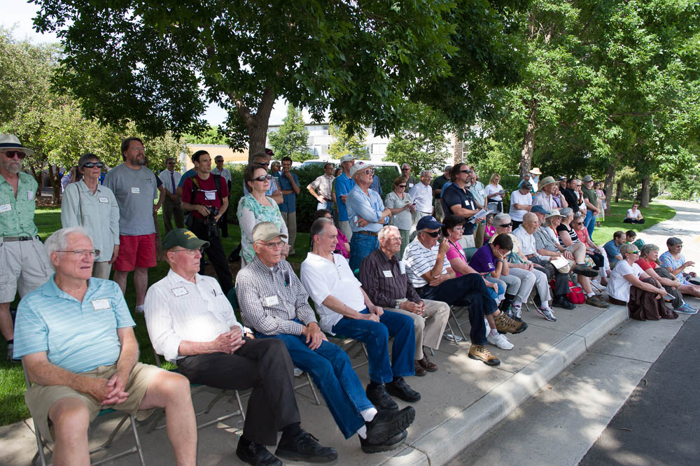

Slide 16
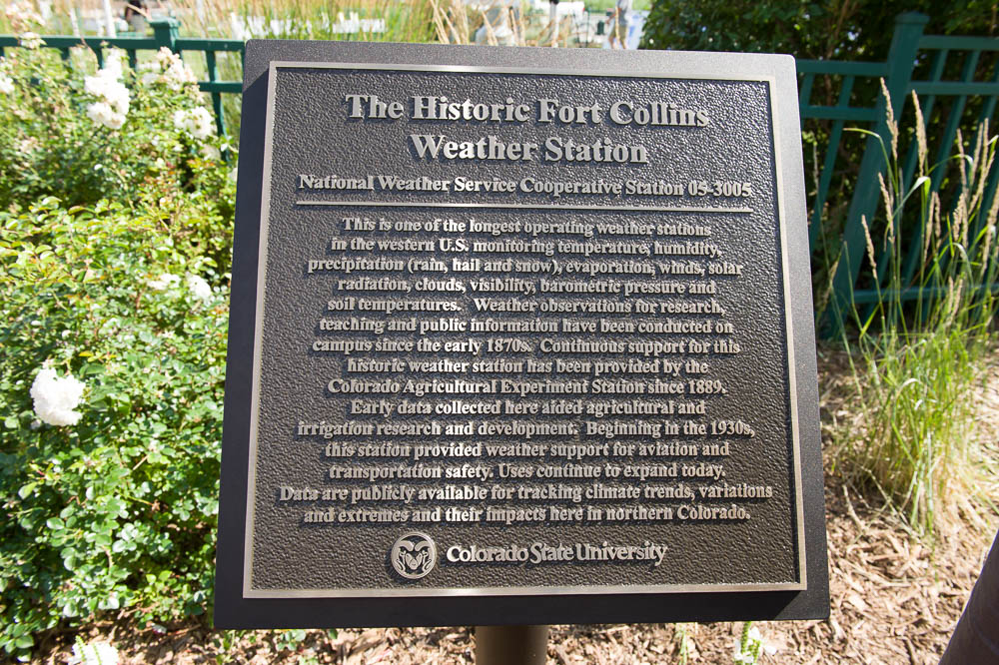

Slide 17
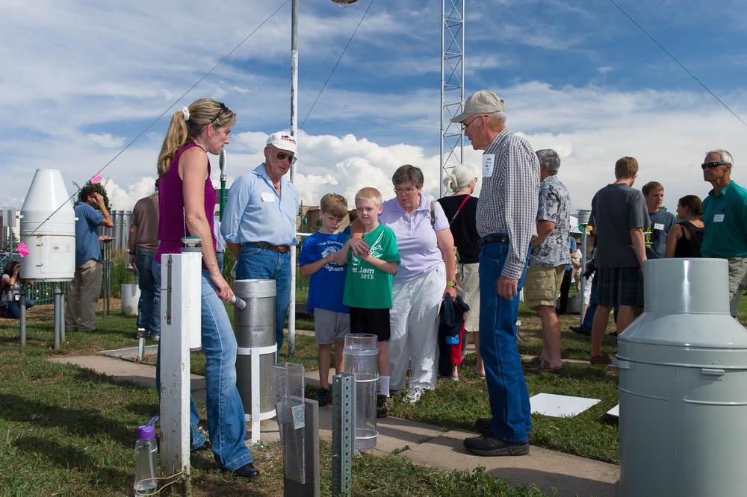

Slide 18
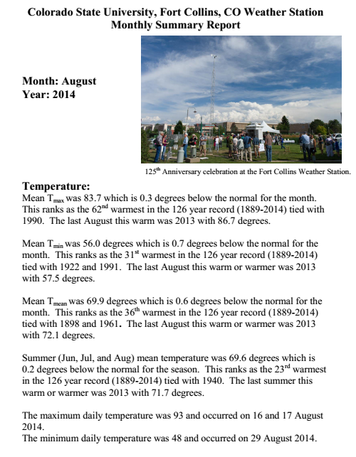
Monthly updates on temperature, precipitation, snowfall, evaporation.
Puts current weather into long term climate perspective.
Sent via email to a subscription list.
Fort Collins Weather Station Climate Updates

Slide 19
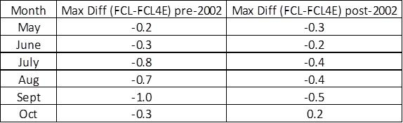
Fort Collins Temperature Continuity
Study was done to quantify the effect of the new transit center construction on temperature readings.
0.4F warming attributed to the construction (July-Oct).
All Fort Collins stations investigated showed an increase in hot summer days.

Slide 20
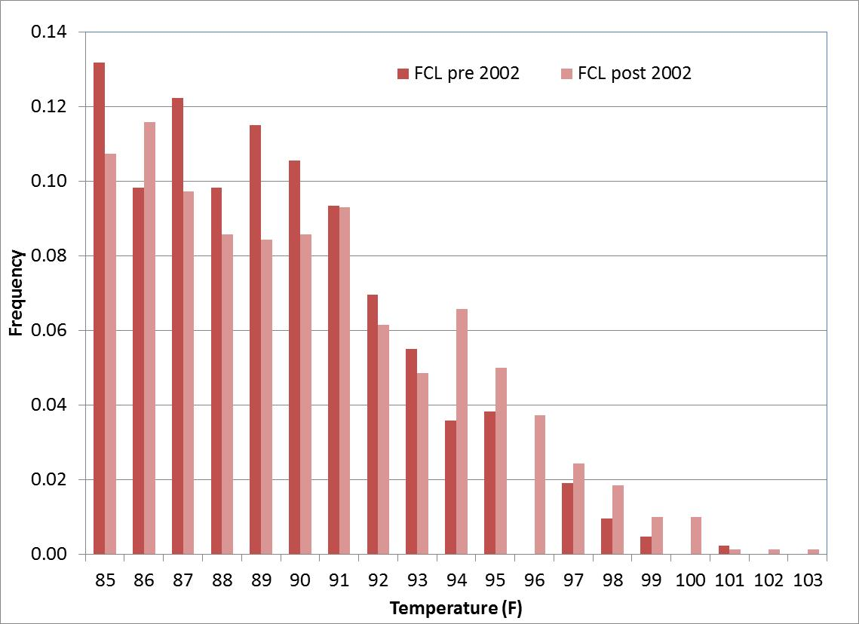
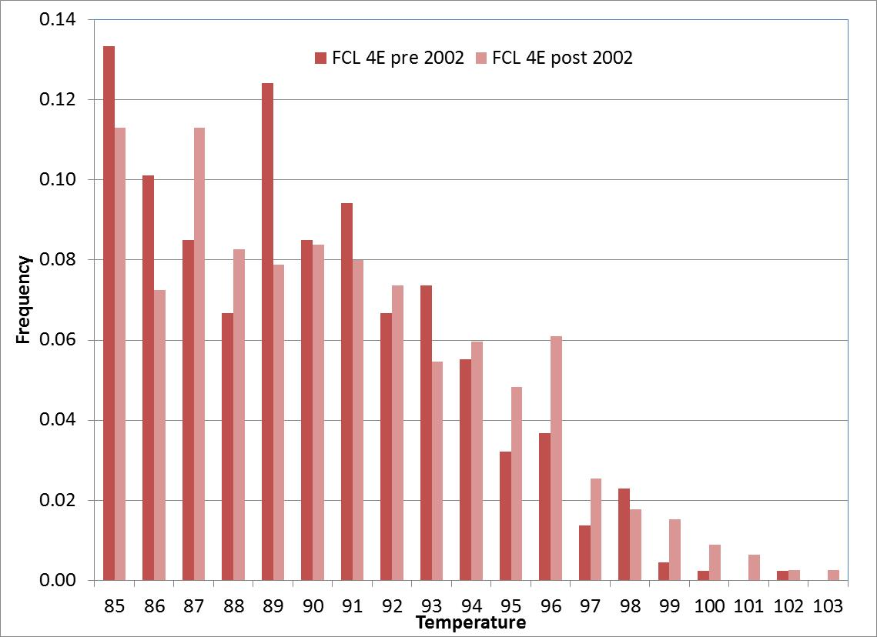
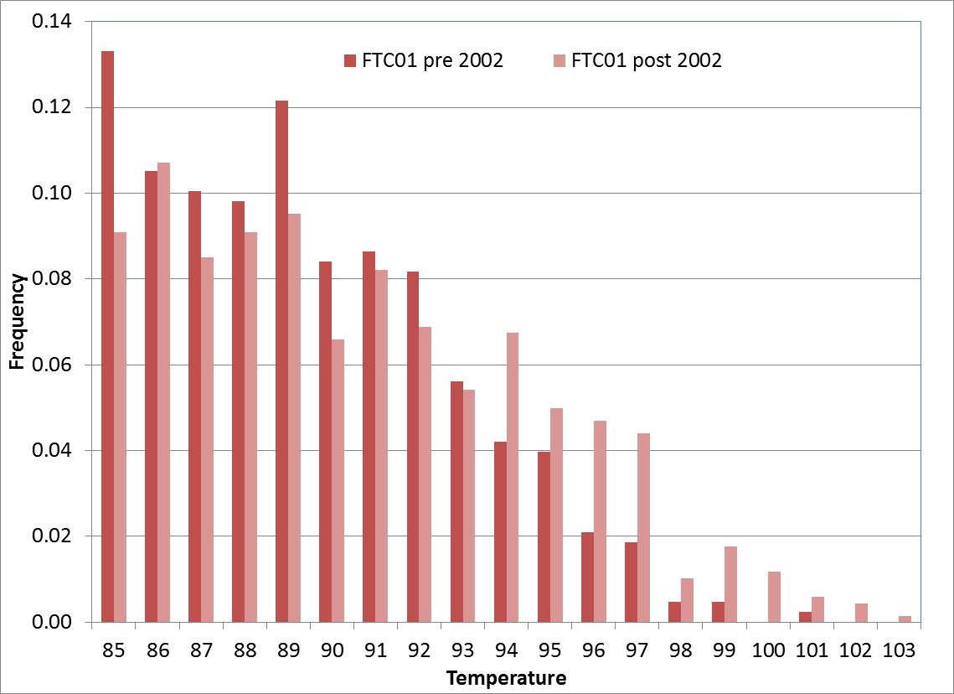
Pre- and Post-2002 Frequency of >=85 degree maximum temperatures
FCL
FCL4E
Each station analyzed in Fort Collins shows an increase in the frequency of days with maximum temperatures >=94 degrees in the Post-2002 period.
This suggests that the transit center is likely not the only contributing factor to the 0.4F warming on days >=85 degrees maximum temperature.
FTC01

Slide 21
Rain gauge comparison
NWS Standard Rain Gauge compared to 4” diameter All-weather gauges used by NWS, CoCoRaHS etc.
And Wedge gauge comparison

Slide 22
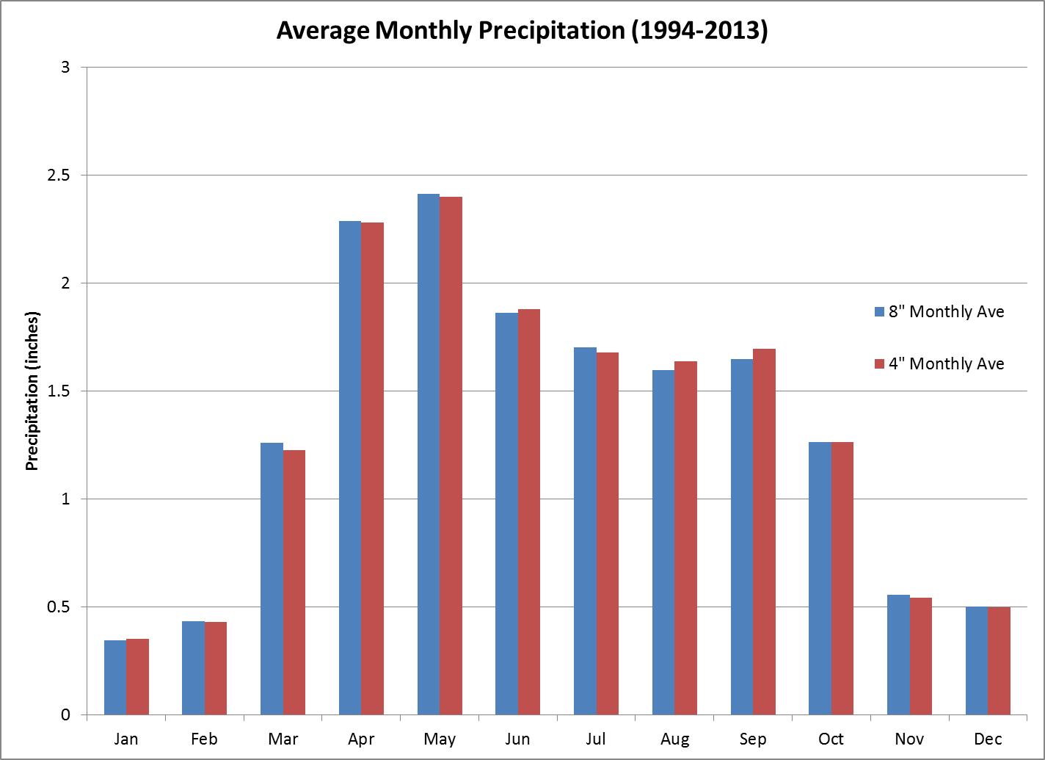

Slide 23
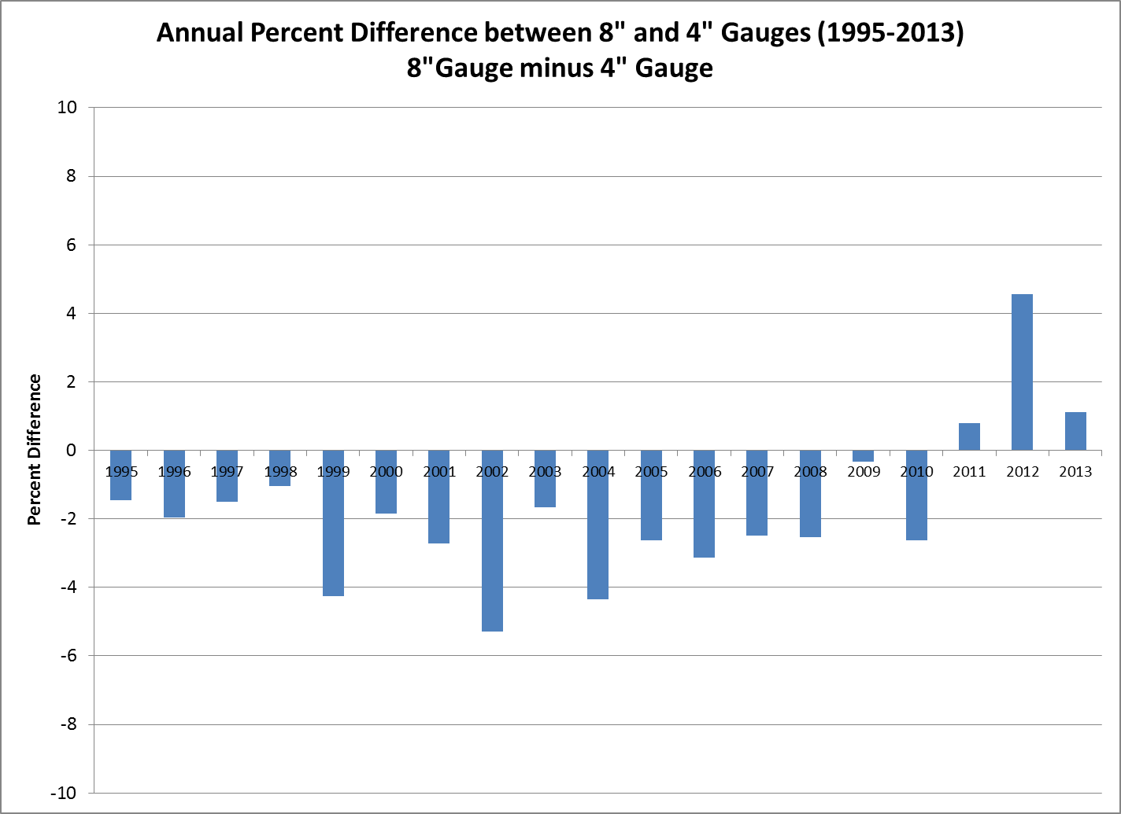

Slide 24
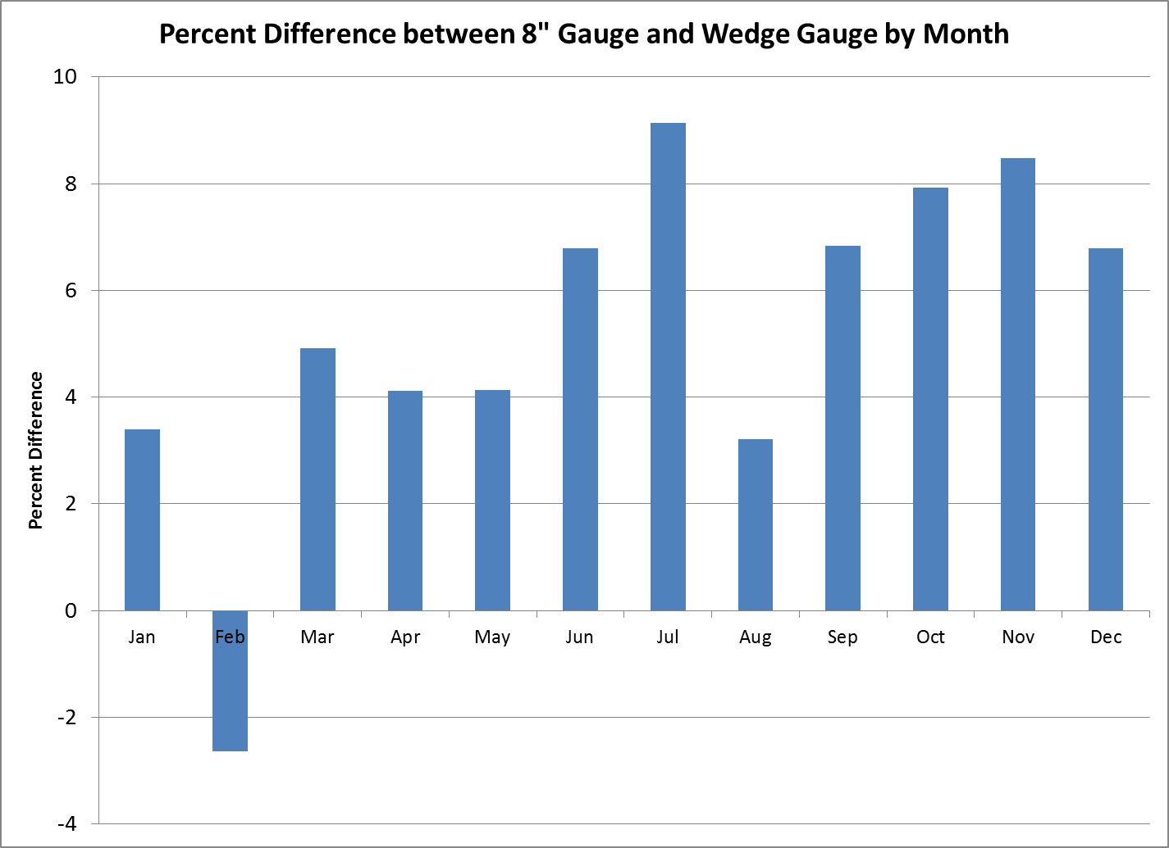
Total Percent Difference: 5.8%

Slide 25
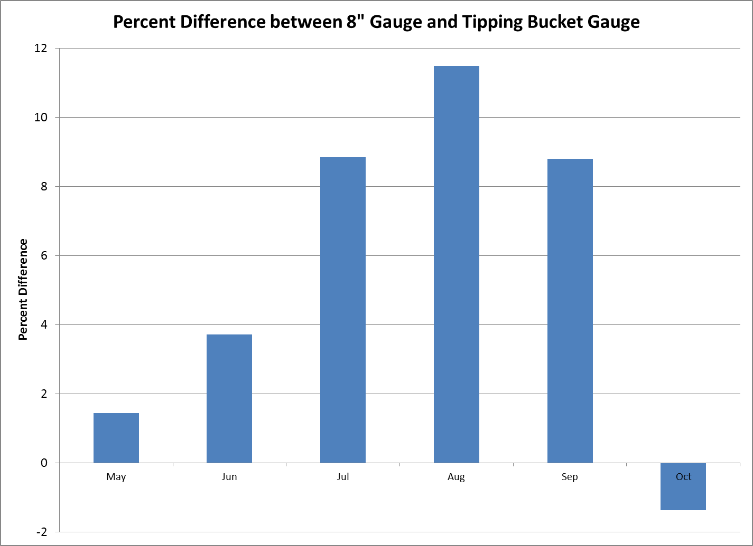
Total Percent Difference: 5.3%

Slide 26
New Colorado one-day rainfall record set 12 Sep 2013
Fort Carson Rod and Gun USGS observing station
-- 11.85” calendar day total
-- 12.46” for 24-hour period ending 9 AM Sep 13, 2013

Slide 27
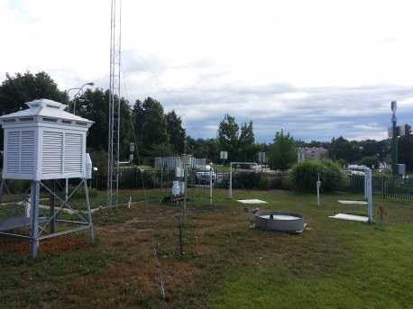
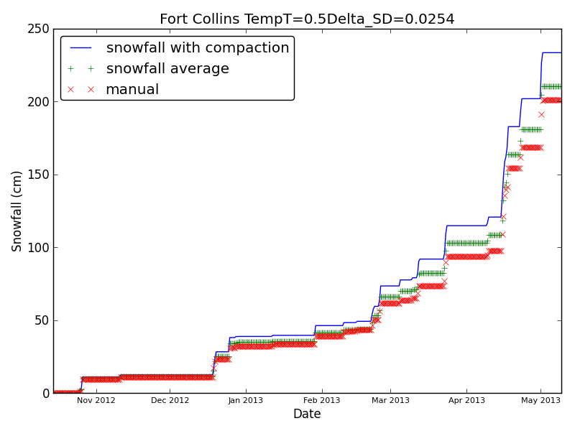
Ultrasonic Snow Sensor Study
Automated sensors to restore snowfall measurement as automated stations.
Algorithm utilizes precipitation, snow depth changes, temperature and wetness sensor to calculate snowfall from continuous snow depth observations.
Fairly good agreement at three locations to manual observations.
  Biggest issue is low density events that are generally < 0.5 inch in depth.
Fort Collins snowfall algorithm results for 2013.

Slide 28
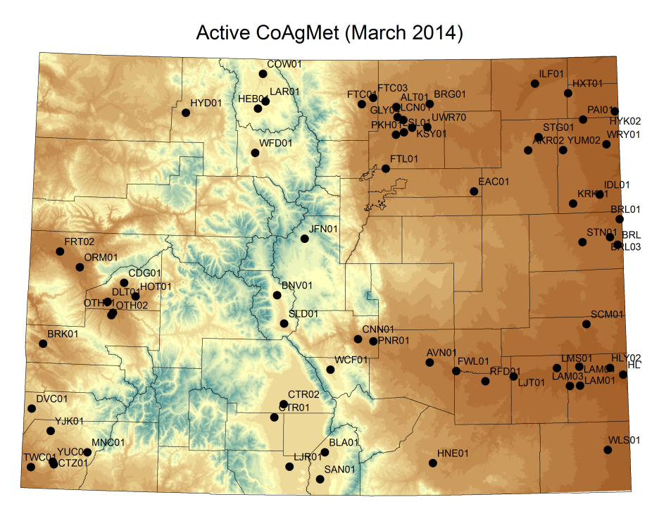
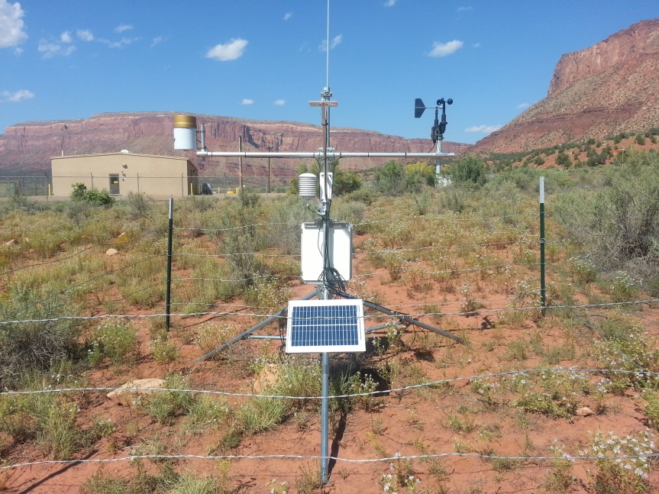
CoAgMet
70 station agricultural weather network.
In operation since early 1990’s, continues to grow.
Majority of stations use cellular or landline phone communications.
Measures: temperature, humidity, solar radiation, wind speed/direction, soil temperatures, precipitation and some now measure soil moisture.
Calculations of ET for irrigation scheduling.
New irrigation scheduling tool being developed for producers.
Bedrock, CO BRK01 – installed Nov 2013

Slide 29
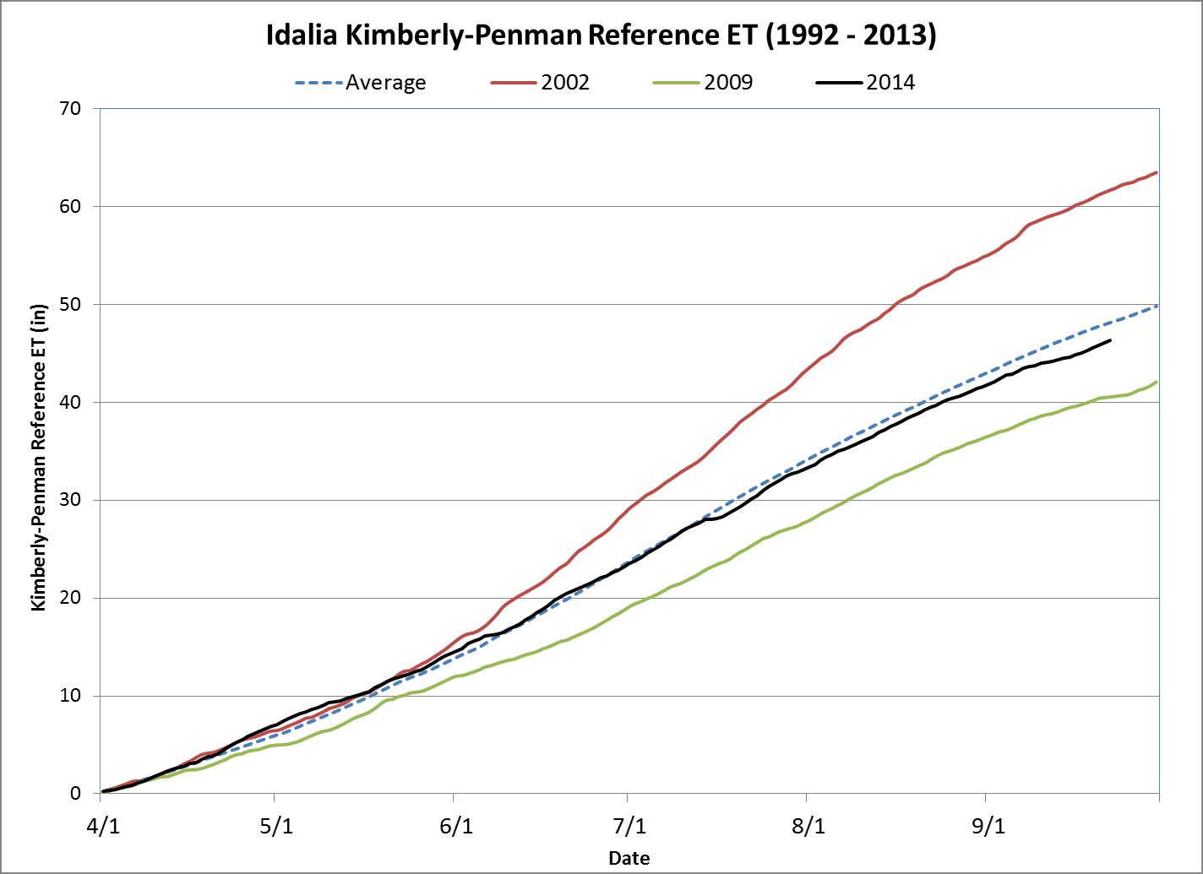
Tracking Evapotranspiration Demand with CoAgMet

Slide 30
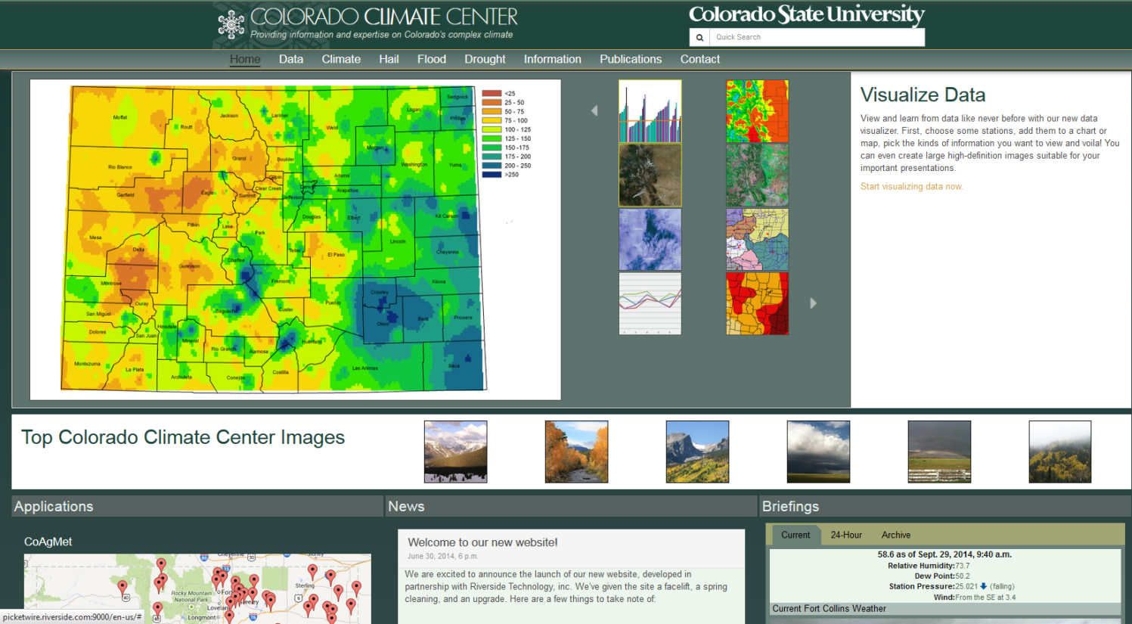
Website ReDevelopment
Contracted with Riverside Technologies to redesign our website, data access and display.
Work is currently underway along with product development.
Data access driven by ACIS (Applied Climate Information System) for more timely data access.

Slide 31
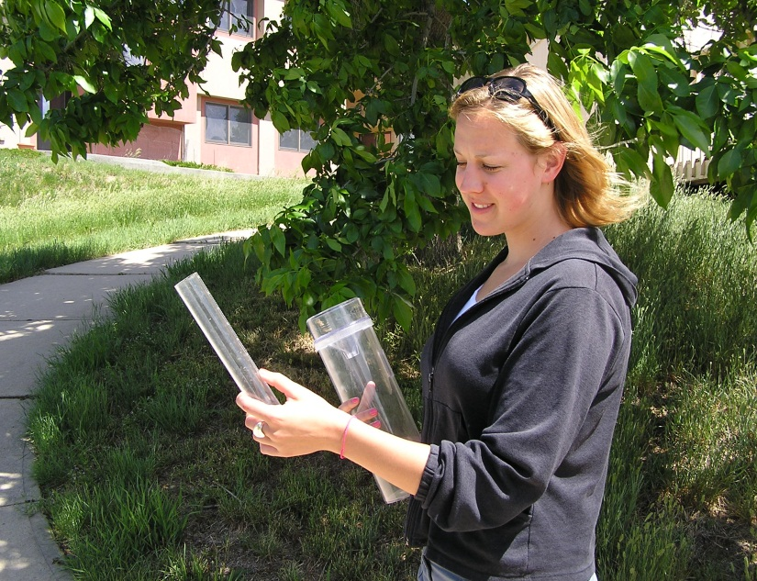
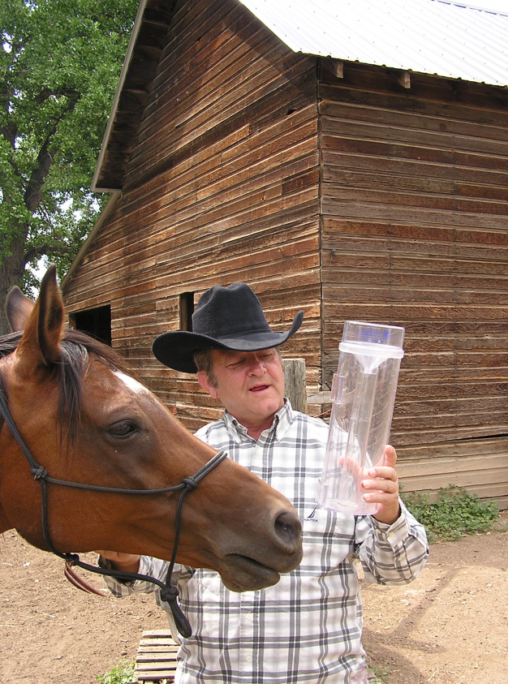
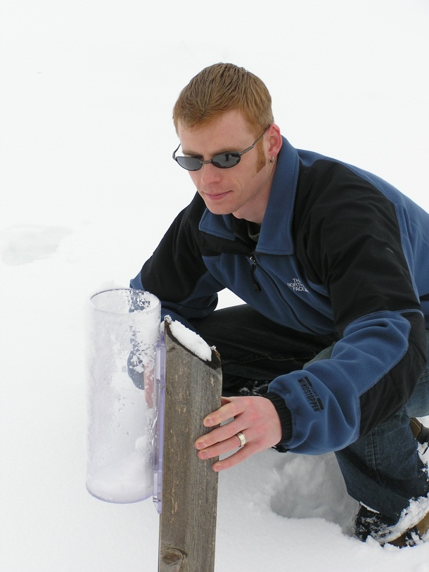
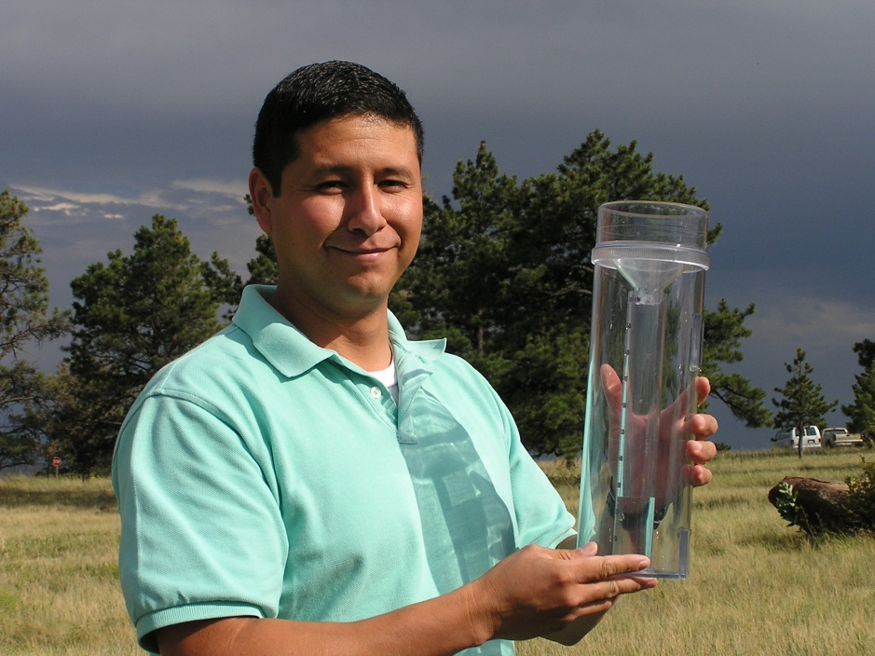
CoCoRaHS -- catching Precip. Data
Photos by H. Reges

Slide 32
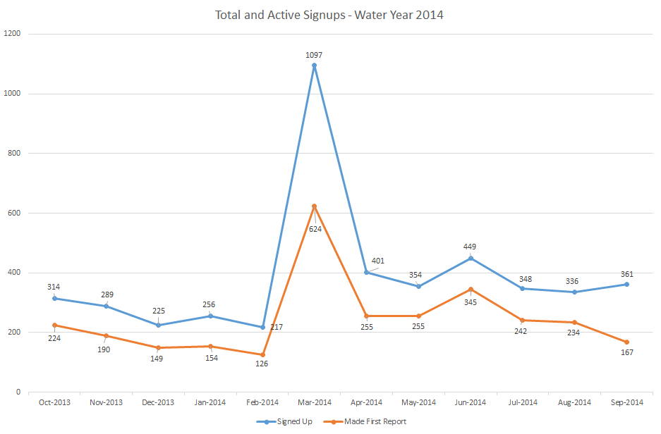
CoCoRaHS Recruiting Continues
4647 new signups in past year
2965 (64%) have begun to
send in reports

Slide 33
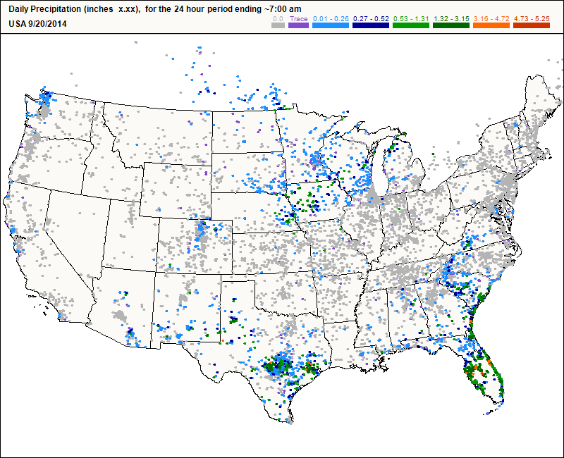

Slide 34
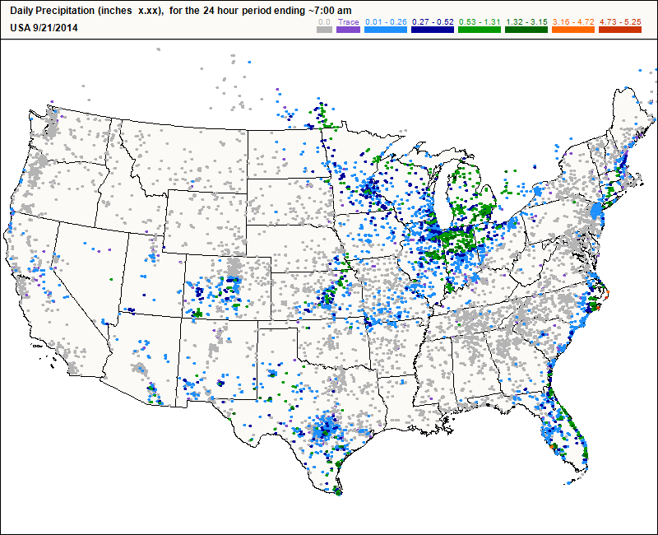

Slide 35
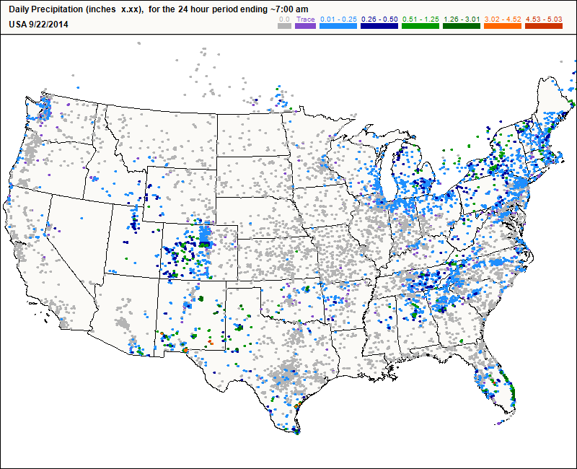


Slide 36
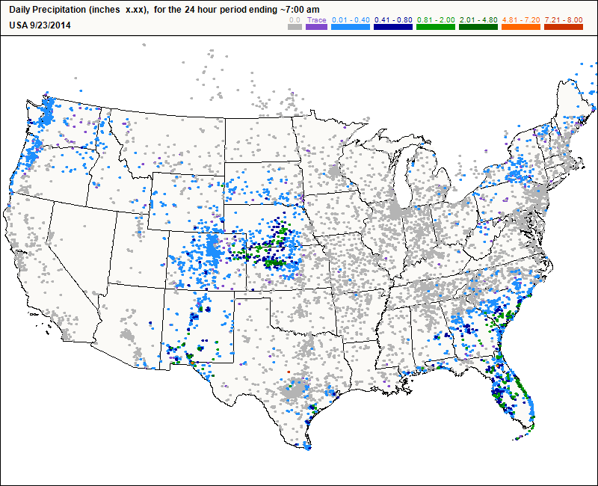

Slide 37
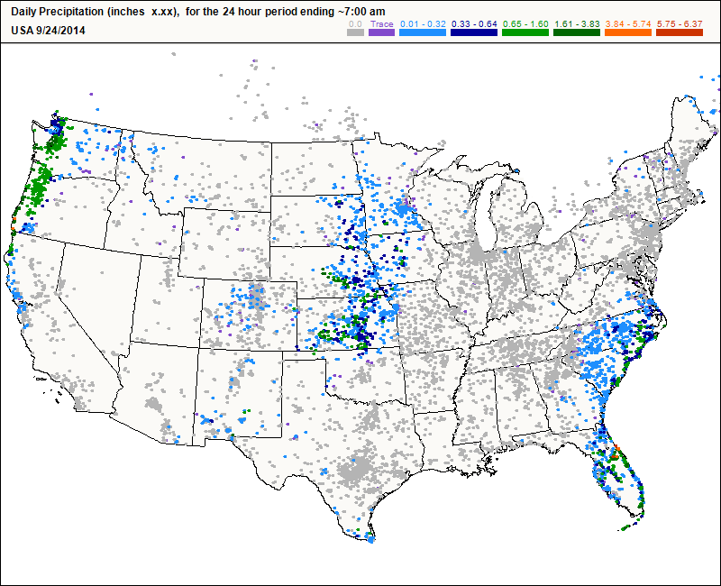

Slide 38
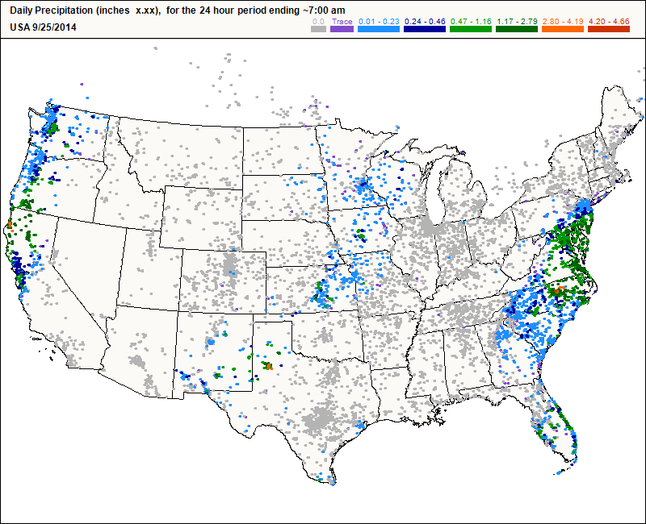

Slide 39
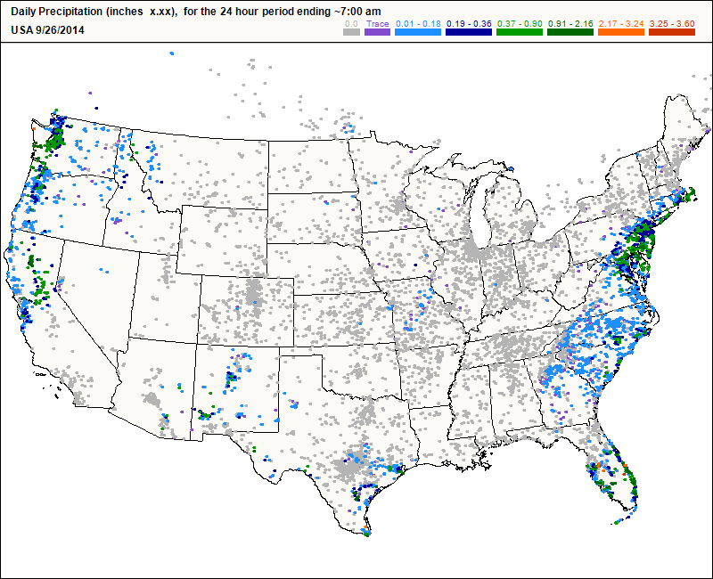

Slide 40
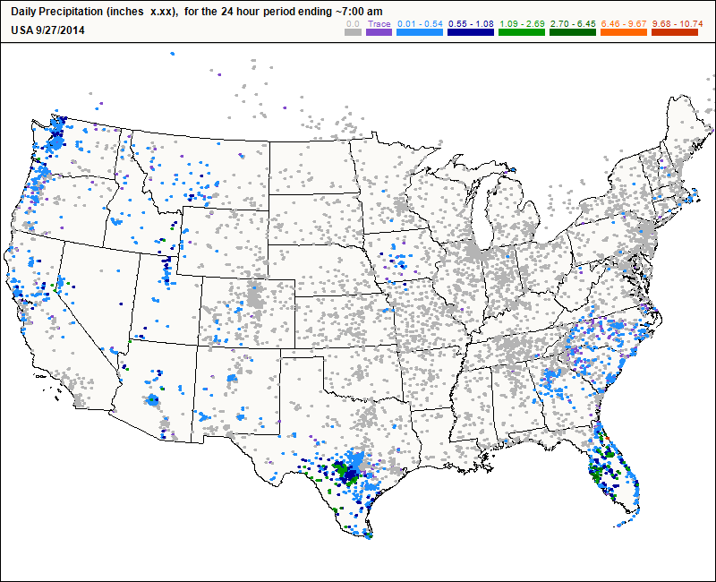

Slide 41
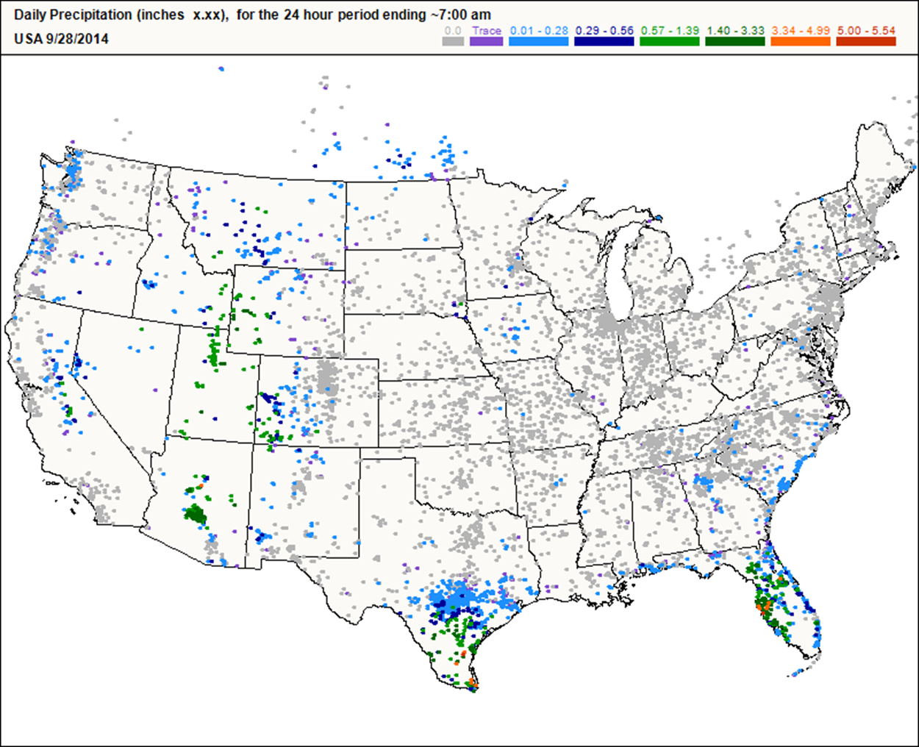

Slide 42
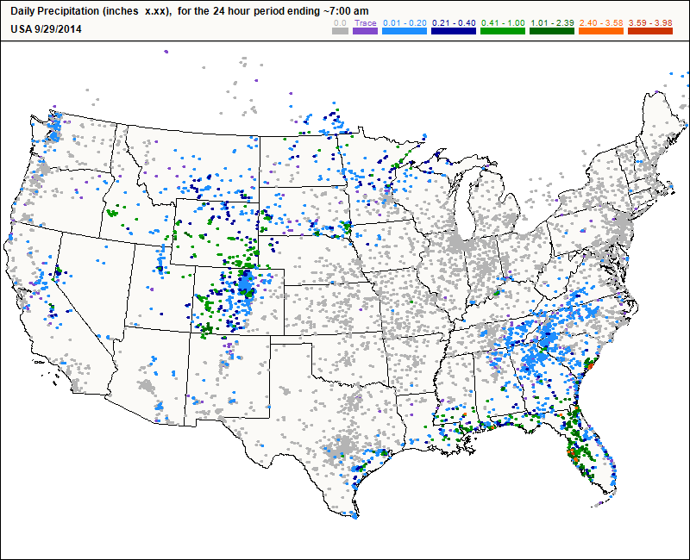
CoCoRaHS still growing

Slide 43
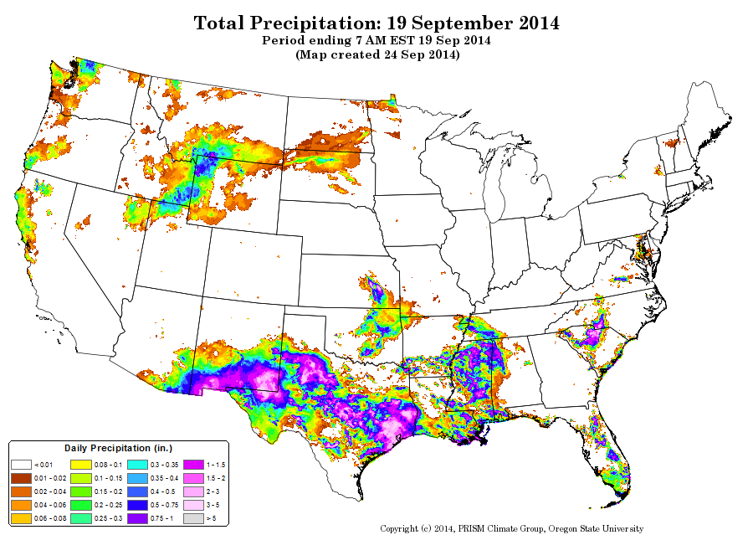

Slide 44
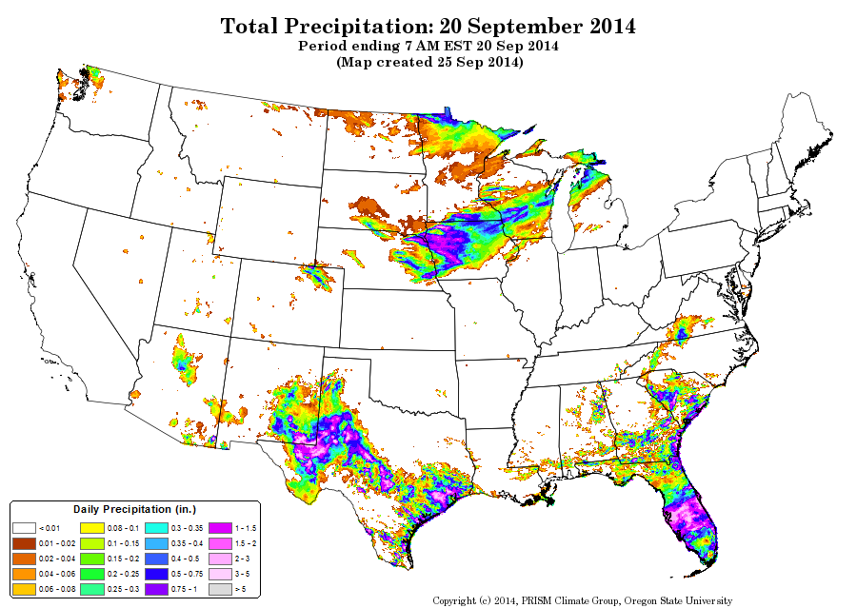

Slide 45
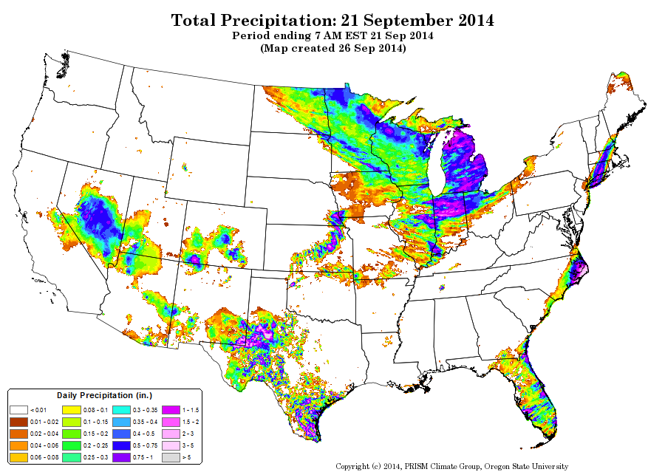

Slide 46
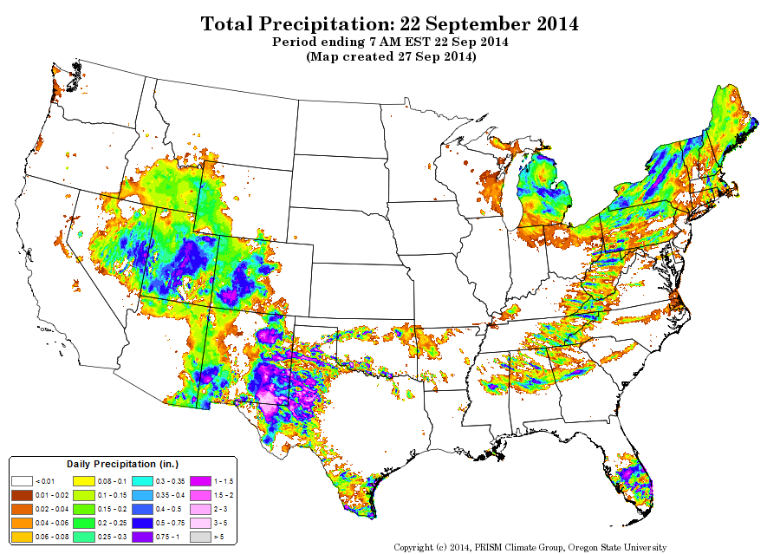

Slide 47
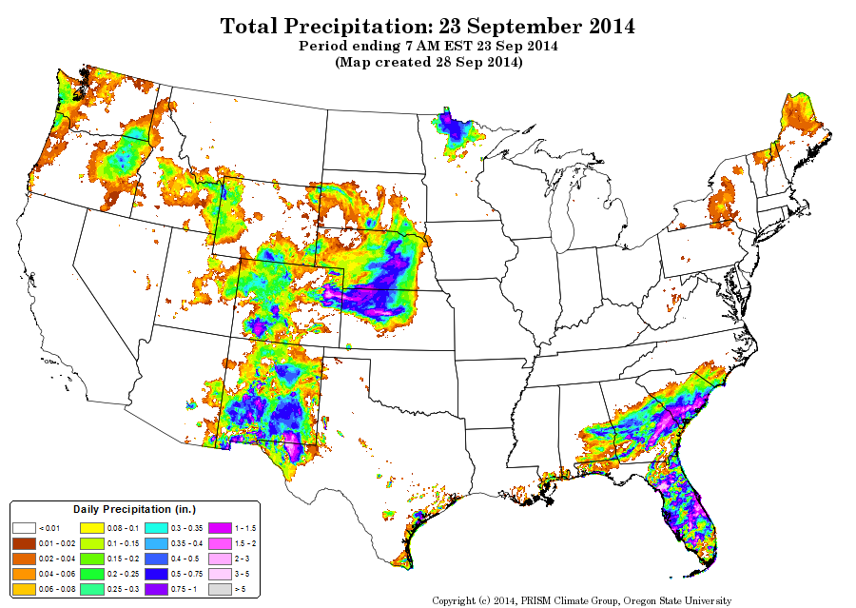

Slide 48
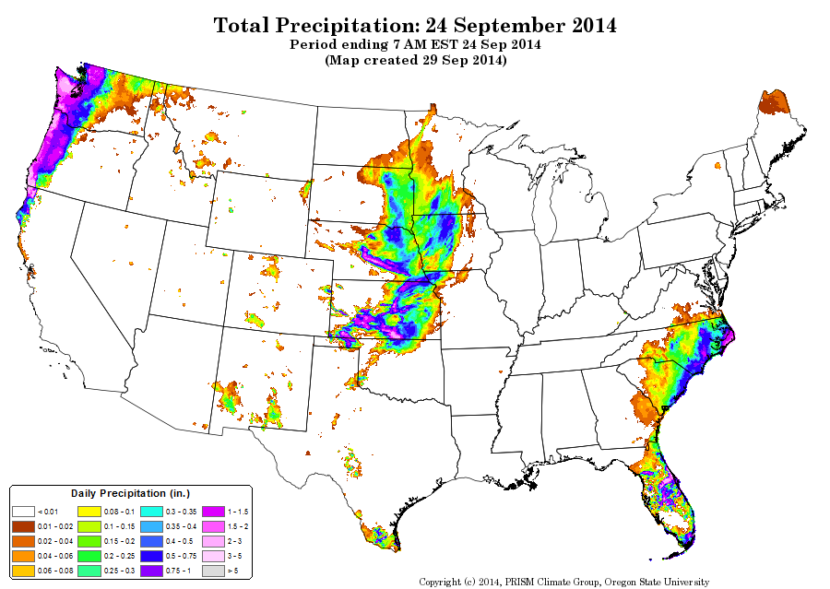

Slide 49
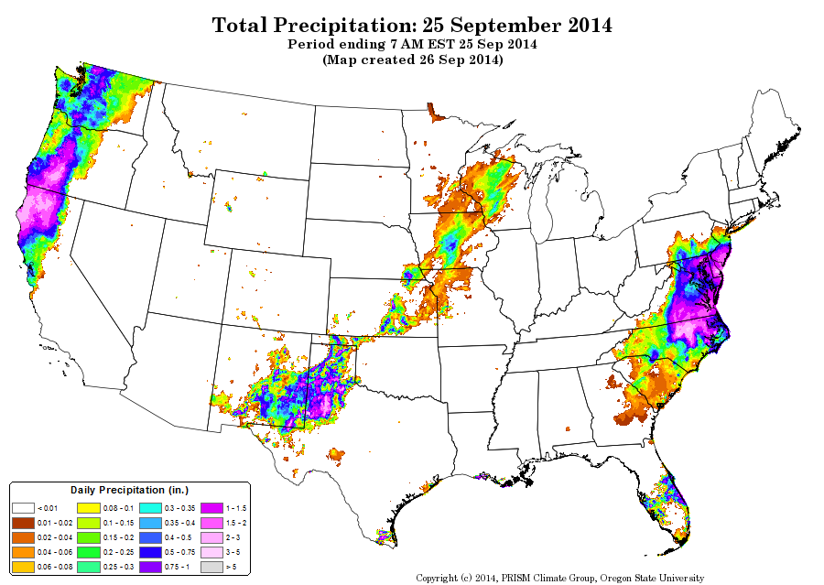

Slide 50


Slide 51


Slide 52


Slide 53

WERA 1012 Coordinating volunteer precipitation data collection

Slide 54

Committee Hard at Work May 2014

Slide 55

Still Working – but not as hard

Slide 56

iPhone (and Android) Apps

Slide 57

New Maps Coming to CoCoRaHS
(with new features including accumulation)
22-

Slide 58

Evaluation

Slide 59

Recruiting and Retention Analysis
Number of days reported by month, i.e. 25 out of 30 possible days = 83%

Slide 60

CoCoRaHS For Schools
2014 Statistics:
Attended 10 outreach events reaching over 1000 people
Since 2010
178 registered schools in Colorado
718 schools registered nationwide
422 schools have reported data
The ‘Make it Rain’ Game
Activities and lesson plans include measuring, reporting and data analysis. All are aligned to meet state and national standards for science, math, geography and more!

Slide 61

Climate Education -- Webinars

Slide 62

Climate Education: Cartoons
Water Cycle animation -- over 250,000 views
https://www.youtube.com/

Slide 63


We even do calendars! HOW ODD
But gorgeous!

Slide 65


We continue to do weekly Drought, Climate and Water Assessments

Slide 66
Becky Bolinger (Smith) completed her PhD on water balance assessment in the Upper Colorado River Basin
She is now doing similar work for NOAA’s Great Lakes Environmental Research Labs – applied to the challenge of Great Lakes water level predication

Slide 67
We have added Peter Goble to our NIDIS drought monitoring team
His M.S. research is on incorporation of soil moisture observations and modeled estimates in operational drought monitoring.

Slide 68


Using Numerical Models To Assess Soil Moisture in the Drought Monitor Region
June 2012 Soil Moisture Levels given by Land Data Assimilation Model Ensemble (% of average)

Slide 69

Using In-situ Soil Moisture Measurements to Corroborate Model Data

Slide 70

Detecting Problematic Biases in In-Situ Observations to Understand their Limitations

Slide 71

We’ve also spent a lot of time this year studying extreme precip. and floods
Credit: Bob Henson, UCAR

Slide 72

September Rainfall data from 2,600 gauges!!!
Unprecendented!

Slide 73


Slide 74


With a private-public team effort, Radar data were incorporated with the gauge data
via the Storm Precipitation Analysis System
Map created with the Storm Precipitation Analysis System (SPAS) through a collaborative effort by Applied Weather Associates, LLC, MetStat, Inc. and the CSU Colorado Climate Center.
Radar data supplied by Weather Decision Technologies, Inc.

Slide 75
Many applications
for high resolution
precipitation data

Slide 76



Boulder Creek
St. Vrain Creek
Boulder Cr
Boulder Creek
S Boulder Creek
Coal Creek
Stage, in feet
Meas 7.5 mi.
downstream
Boulder Cr at North 75th St

Slide 77

St Vrain Creek
Lyons
Lyons
At mouth
Longmont
Below
Longmont
Discharge, in ft³/s

Slide 78


Slide 79
“Climate Change” talk and planning is coming close to being “mainstream”
But not in all places or all audiences

